Slide 1
Student Learning Outcome Process Rebuild
Veronica Avila
Mary Pape
SLO/SSLO/AUO Coordinators
Visit us at deanza.edu/slo/

Slide 2
Outcomes
Attendees will be able to guide others to complete an assessment

Slide 3
Contents
Entering an assessment ASAP
Review and renaming of outcome types
First task on eLumen

Slide 4
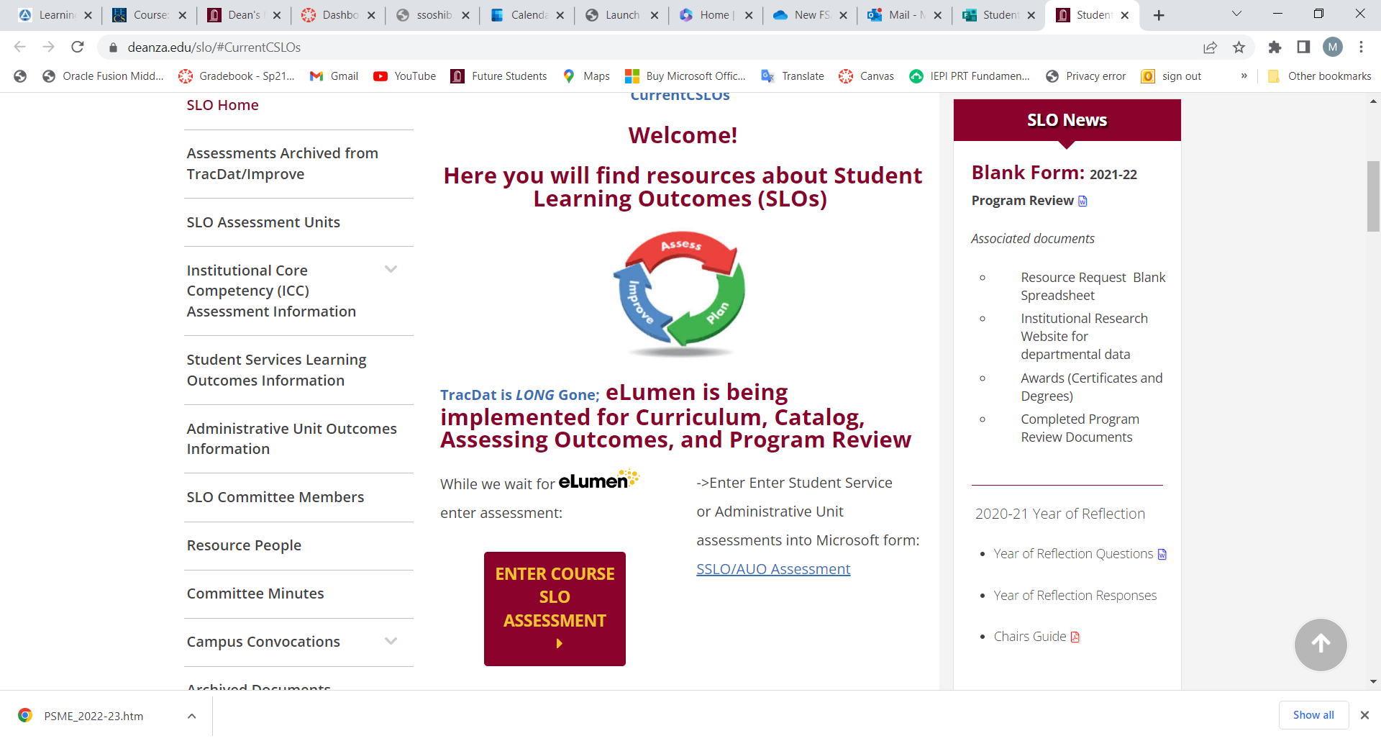
I. How do document an assessment

Slide 5
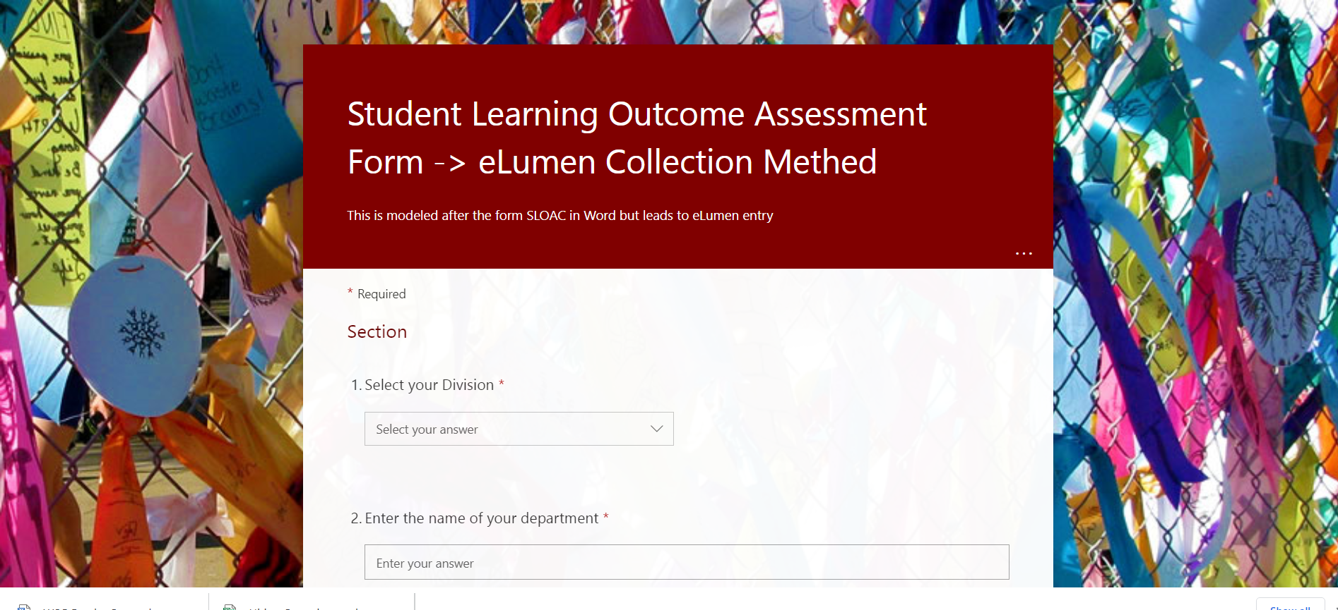

Slide 6
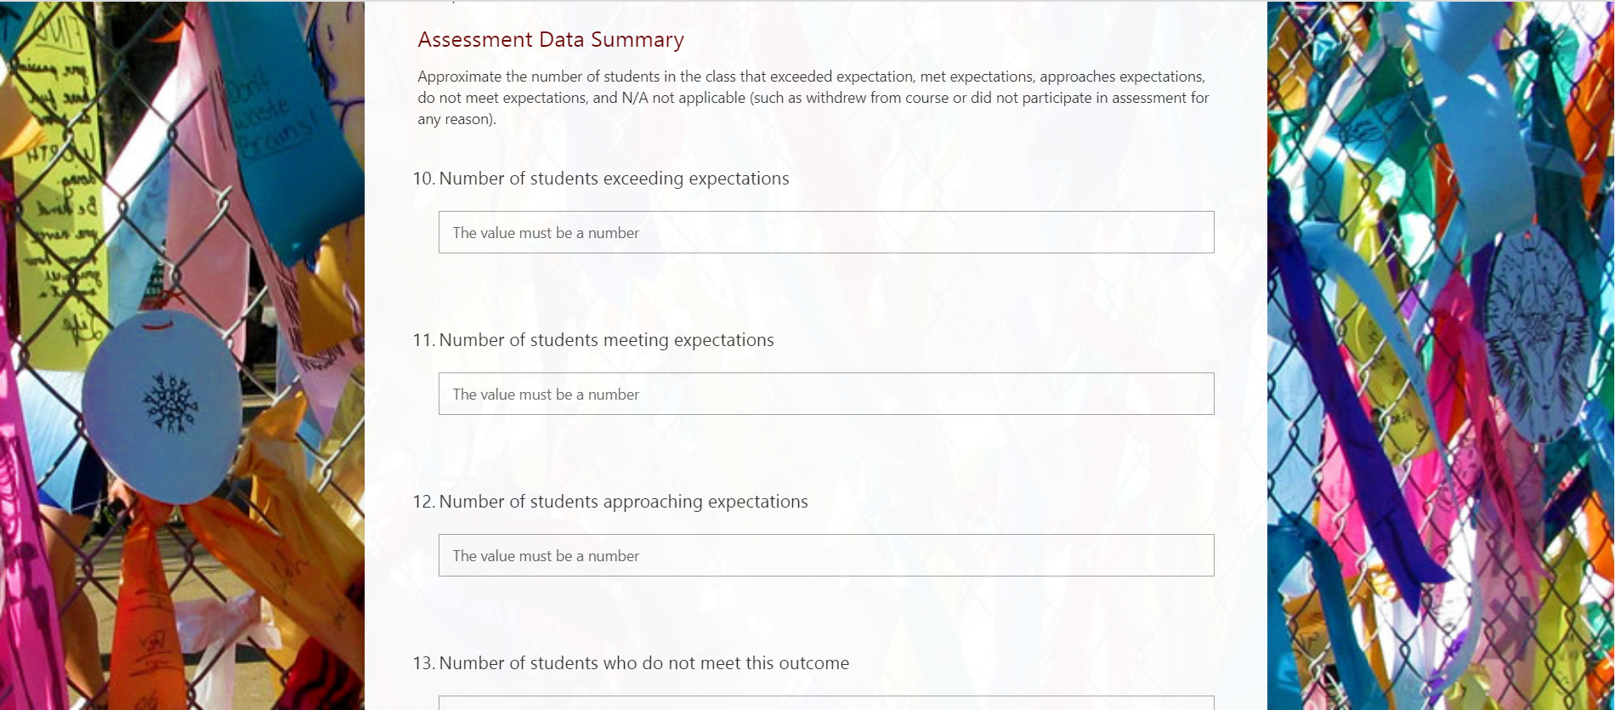

Slide 7
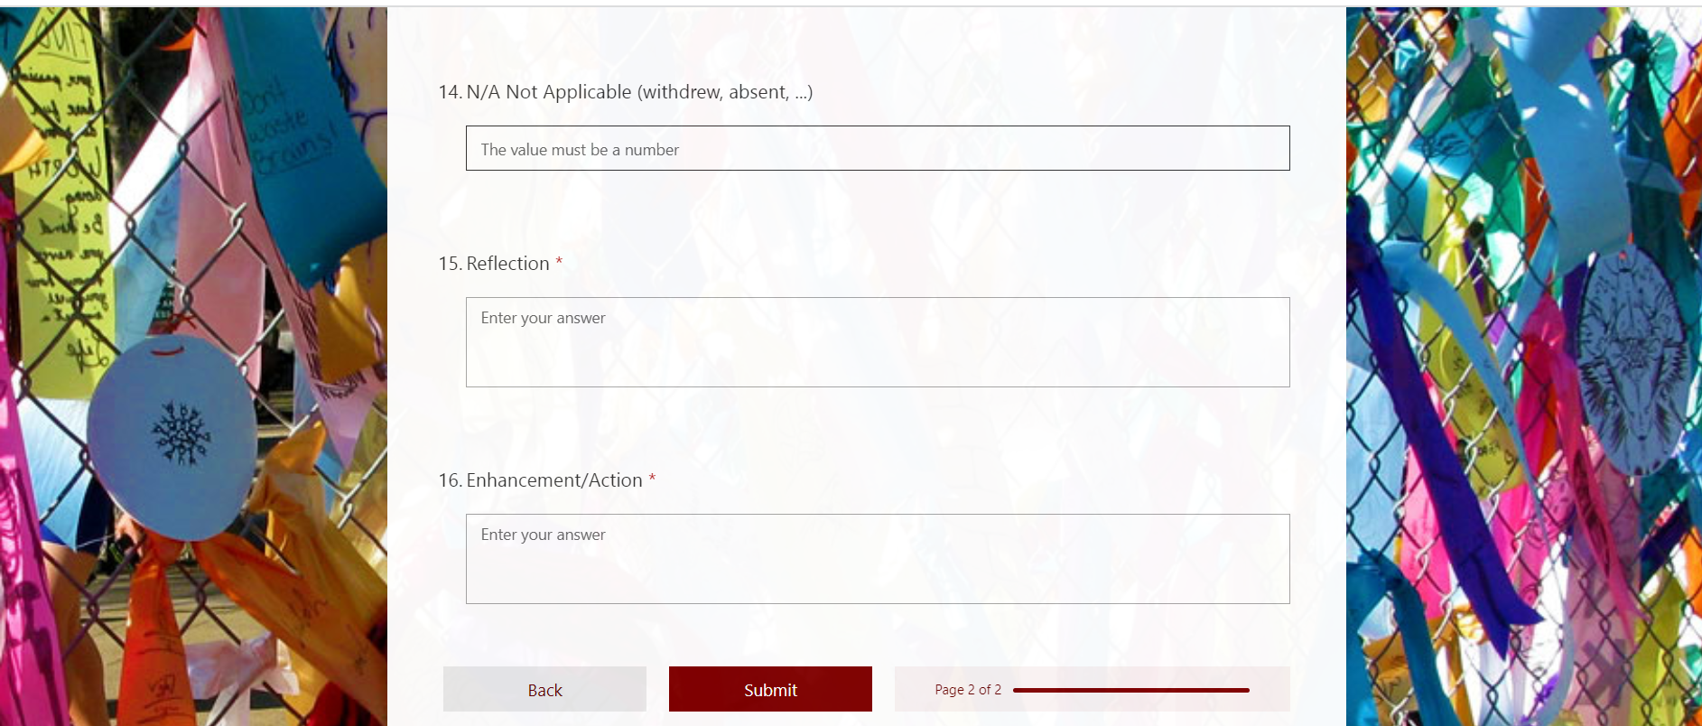

Slide 8
II. Review and renaming of outcome types

Slide 9
LEARNING OUTCOMES - TYPES
Student Learning Outcomes
Course Level (CSLO)
Program Level (PSLO)
Institutional Level (ISLO)
Student Services Learning Outcomes
Administrative Unit Outcomes

Slide 10
I. Student Learning Outcomes Course Level
Attainment of skills and competencies at the end of the course.
Design mobile applications using object-oriented methodology and advanced Java concepts using Android Development Kit. (CIS 37)

Slide 11
I. Student Learning Outcomes Program Level
Attainment of skills and competencies at the after completing a certain certificate/degree.
Design Java programs for the Android platform. (CIS: Programming in Java Certificate of Achievement)

Slide 12
I. Student Learning Outcomes Institutional Level (Institutional Core Competencies)
Communication and expression
Information literacy
Physical/mental wellness and personal responsibility
Civic capacity for global, cultural, social and environmental justice
Critical thinking

Slide 13
III. First task on eLumen

Slide 14
Mapping
Critical
thinking
Communication and expression
Design Java programs for the Android platform.
Design mobile applications using object-oriented methodology and advanced Java concepts using Android Development Kit.

Slide 15
Outcome Defined
(Redefined)
Conduct assessments
Summarizing data
Reflection
Enhancement
Plan methods of assessment

Slide 16
Outcome Defined
(Redefined)
Conduct assessments
Summarizing data
Reflection
Enhancement
Plan methods of assessment
Assess each course at least once per revision cycle = once every five years minimum*
*Core courses should be assessed continually

Slide 17
Your Assignment
Must use the Student Learning Outcome verbatim from the Course Outline of Record
Enter Assessment directly into Microsoft form: SLO Course Assessment

Slide 18
Your Assignment
Select your Division *
Enter the name of your department *
Enter the name of the course with section. For example, MATH 22-50Z *
Enter CRN# for course *
Enter SLO Statement(s) As it (they) appear on the Course Outline of Record. You may assess one or more at a time. *
Academic Year *
Quarter of Assessment *
Modality of class *
Method of Assessment *
Elaborate on Assessment Method *

Slide 19
Your Assignment
Assessment Data Summary
Approximate the number of students in the class that exceeded expectation, met expectations, approaches expectations, do not meet expectations, and N/A not applicable (such as withdrew from course or did not participate in assessment for any reason)

Slide 20
Your Assignment
11. Number of students exceeding expectations
12. Number of students meeting expectations
13. Number of students approaching expectations
14. Number of students who do not meet this/these outcome(s)
15. N/A Not Applicable (withdrew, absent, ...)
16. Reflection *
17. Enhancement/Action *

Slide 21
IV. Meaningful Assessments

Slide 22
Possible CSLO – Meaningful Assessment Survey
I felt welcome in this class. (connected)
I felt connected to other students. (connected)
I felt the instructor really cared about me. (nurtured)
I knew what I needed to do in order to be successful in this course. (directed)
The instructor gave me regular feedback about my performance in the class. (engaged)
The instructor made sure I understood the material. (nurtured)
My identity and individual culture was reflected in the course materials (readings, lectures, videos). (valued)
The instructor challenged me to do the best I could. (engaged)
The course had real-world, practical applications. (engaged)
The instructor made sure I had the opportunity to participate in class discussions. (nurtured)
The instructor directed me to campus resources that helped me perform better in class. (nurtured)
Response options: [All the time, most of the time, rarely, never, not sure]

Slide 23
Using Canvas Quizzes to Create an Anonymous Survey
Select Quizzes from the course navigation.
Select the + Quiz button.
Under the Details tab, give your survey a name, and provide survey instructions in the text box.
Select Ungraded Survey from the Quiz Type menu.
Select the Keep Submissions Anonymous box.
Click on the Questions tab.
Add the questions to your survey. Select from the following question types: Multiple Choice, True/False, Fill In the Blank, Fill In Multiple Blanks, Multiple Answers, Multiple Dropdowns, Matching, Numerical Answer, Formula Question, Essay Question, File Upload Question, and Text (no question).
When done, select Save & Publish.

Slide 24
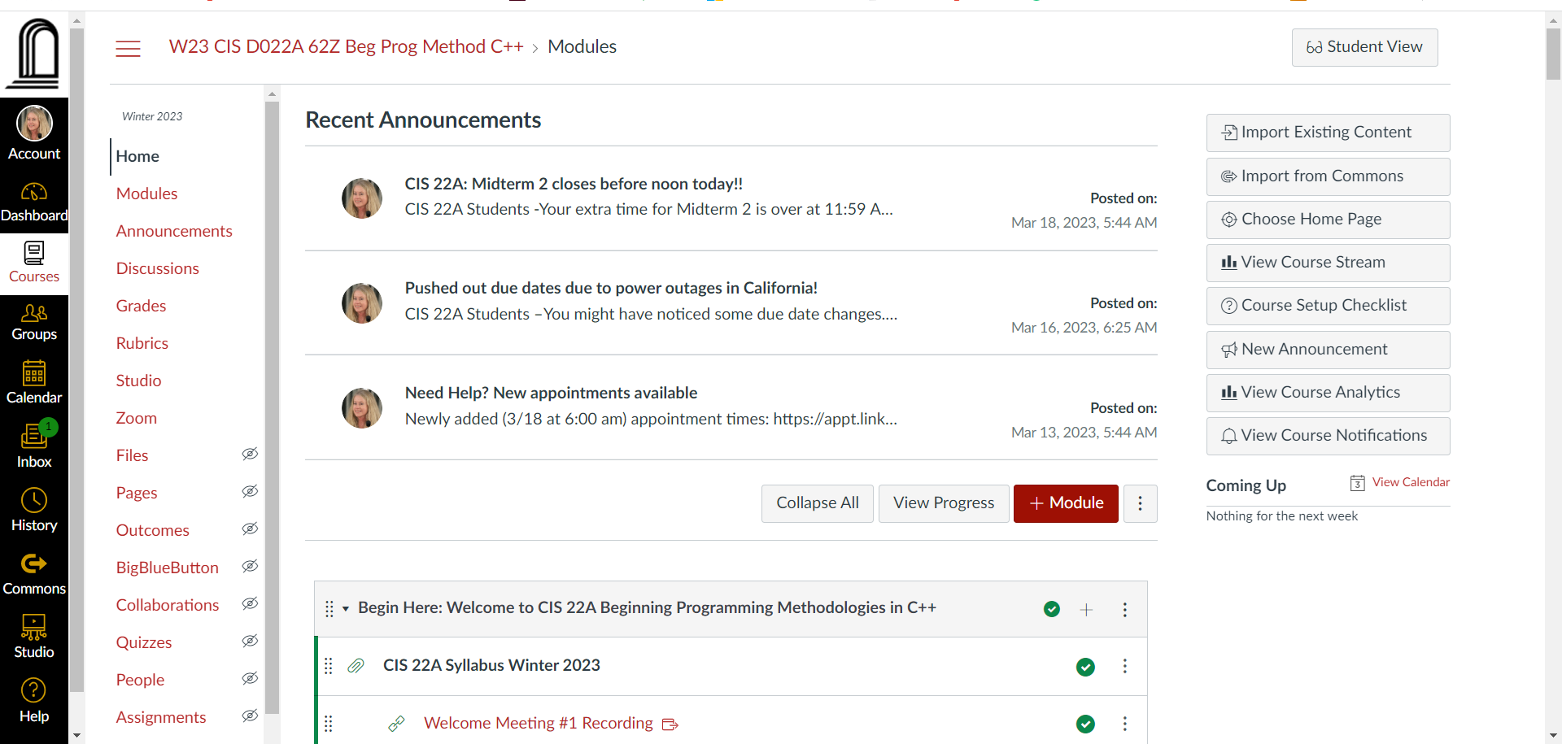
Or import Quiz from Canvas Commons
Import from Commons
Click the title of the resource to open it. Once in the resource, in the Import into Canvas box located on the right side, click the check box next to the course name to select which course the template should be imported in to. Click the Import into Course button to add the template to the course shell.

Slide 25
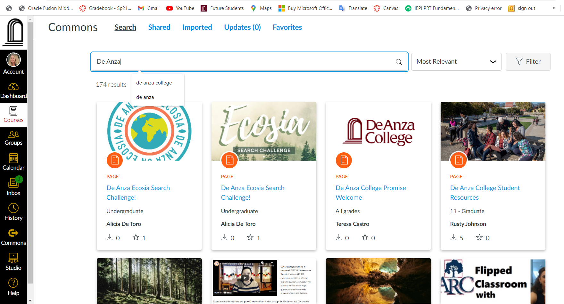
Search

Slide 26
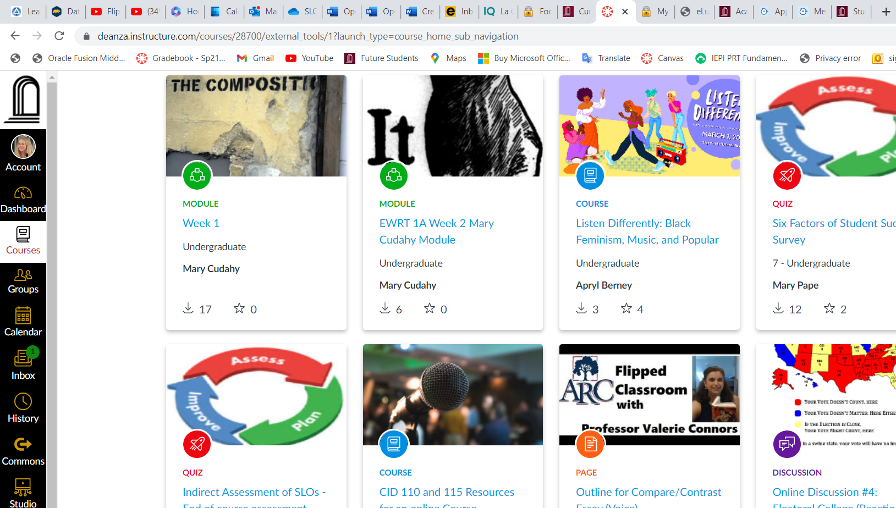
. . . & Scroll

Slide 27
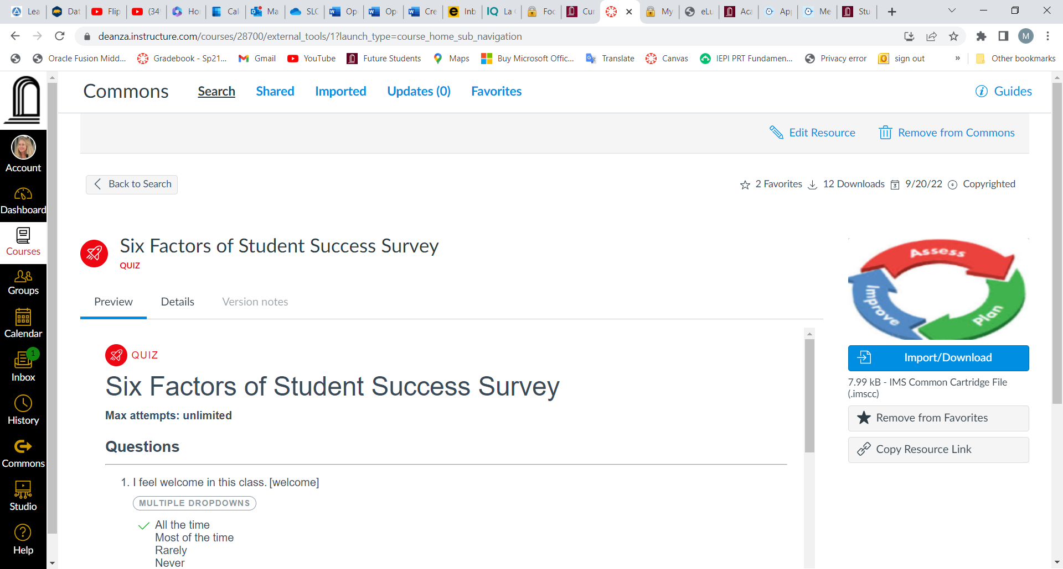
Import and Download

