Slide 1
De Anza Event Center
Campus discussion-Evaluation of needs, February 28, 2020

Slide 2
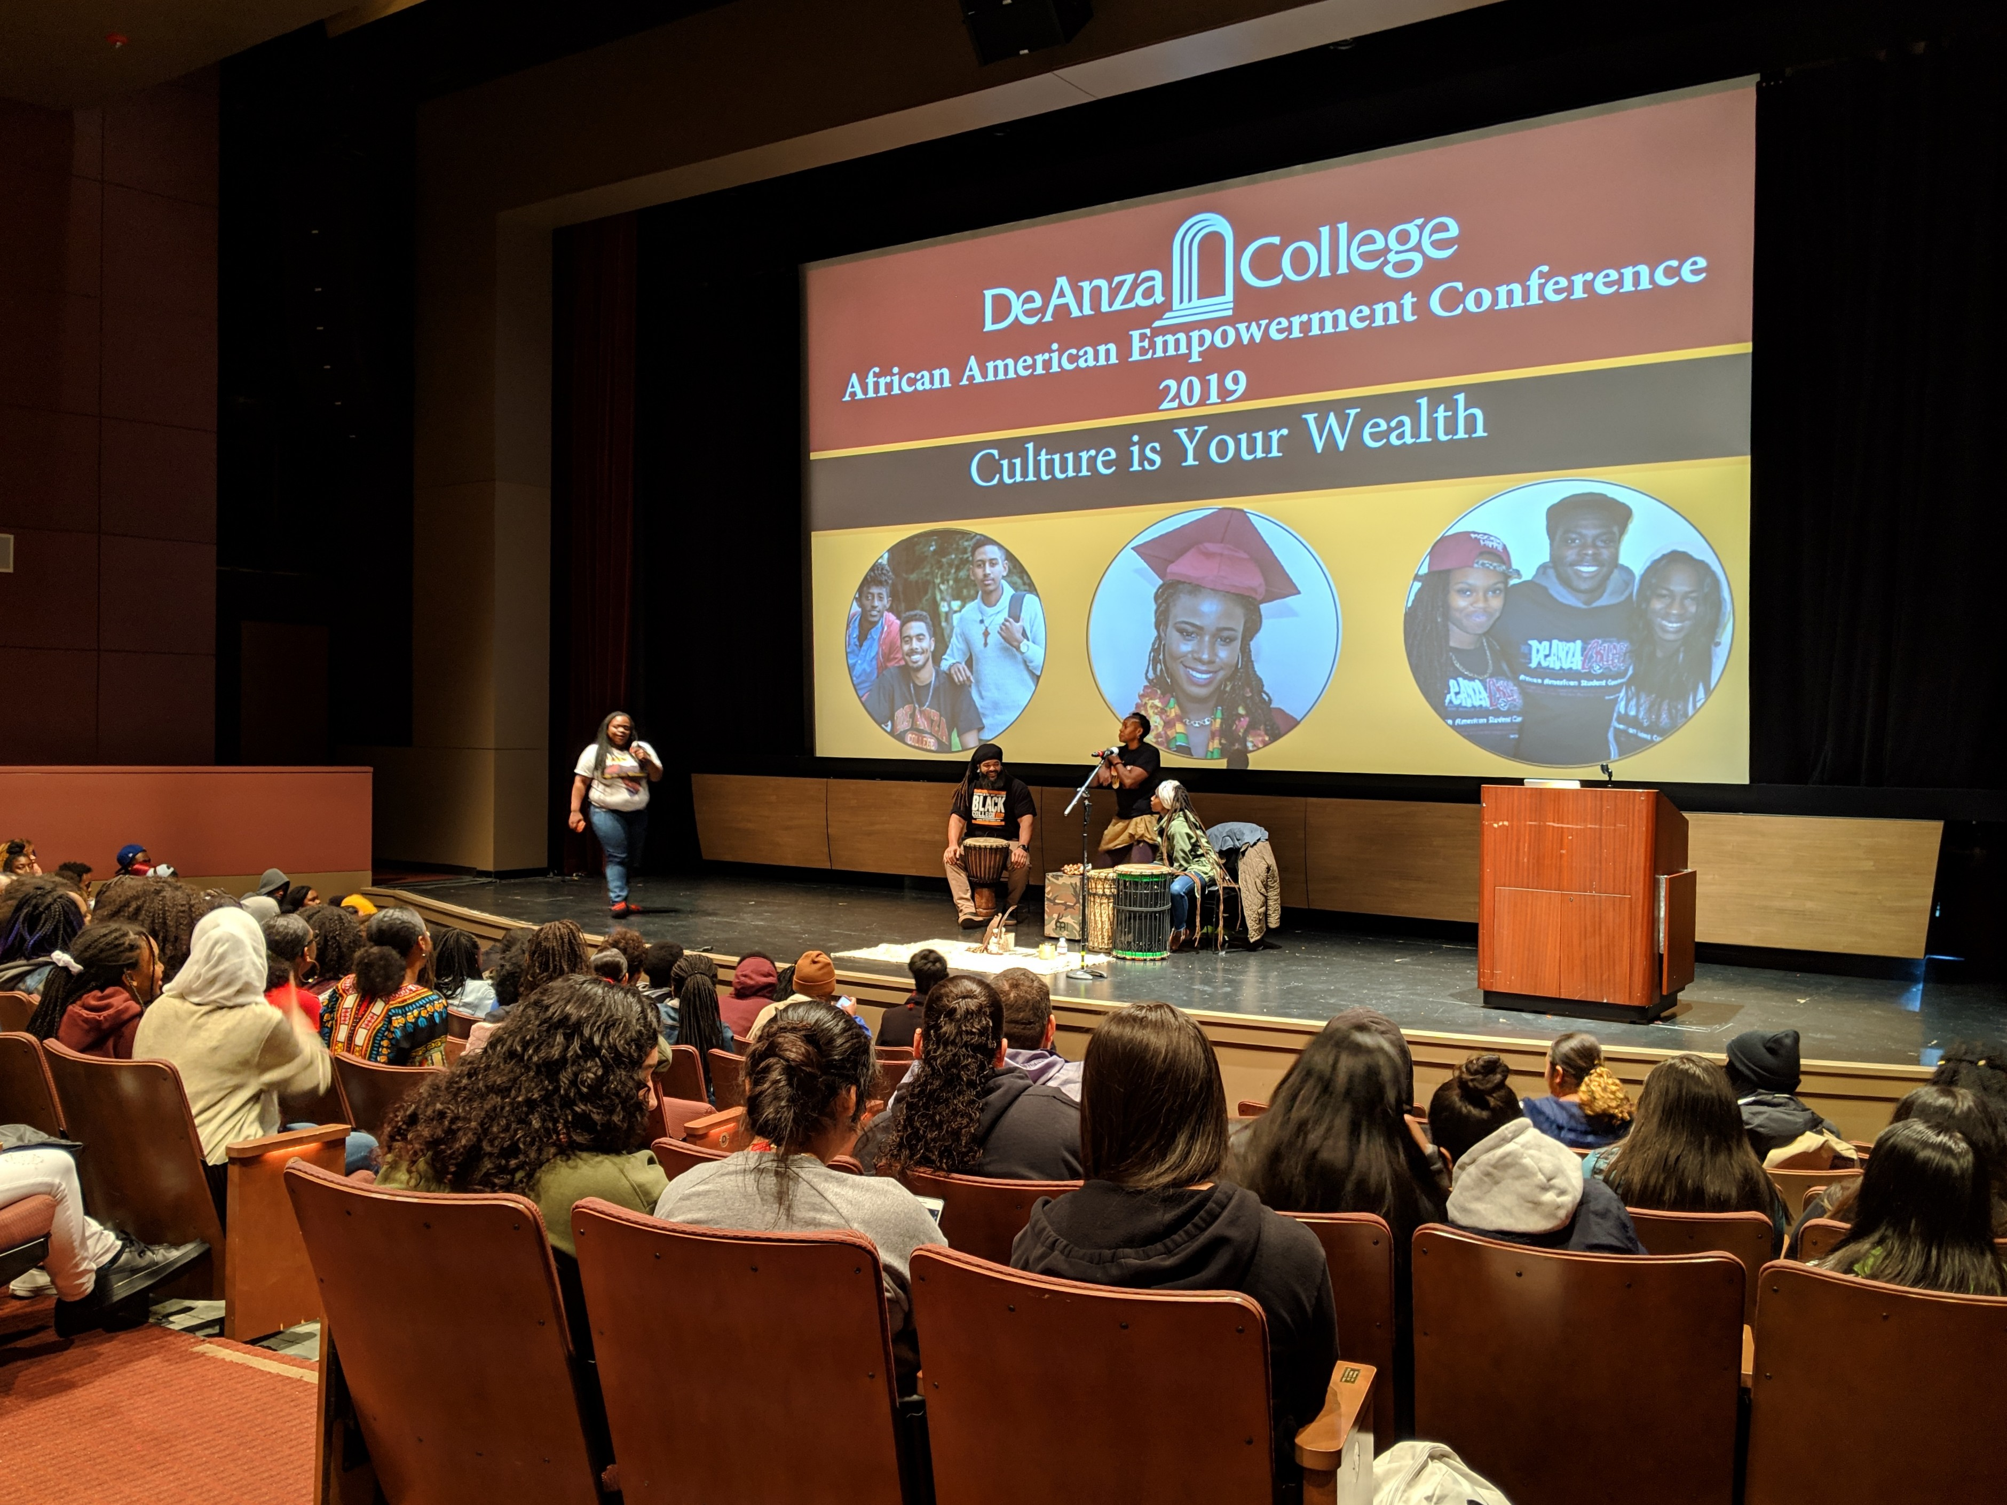
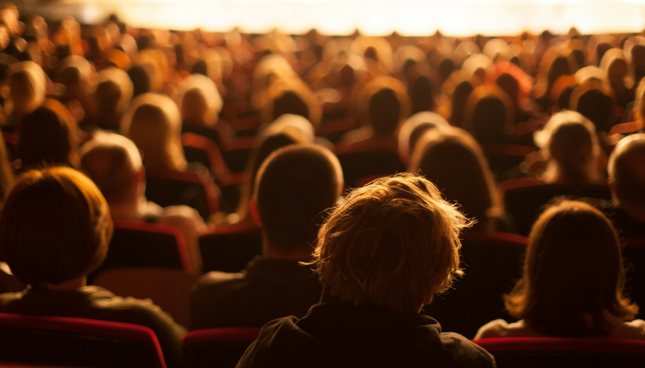
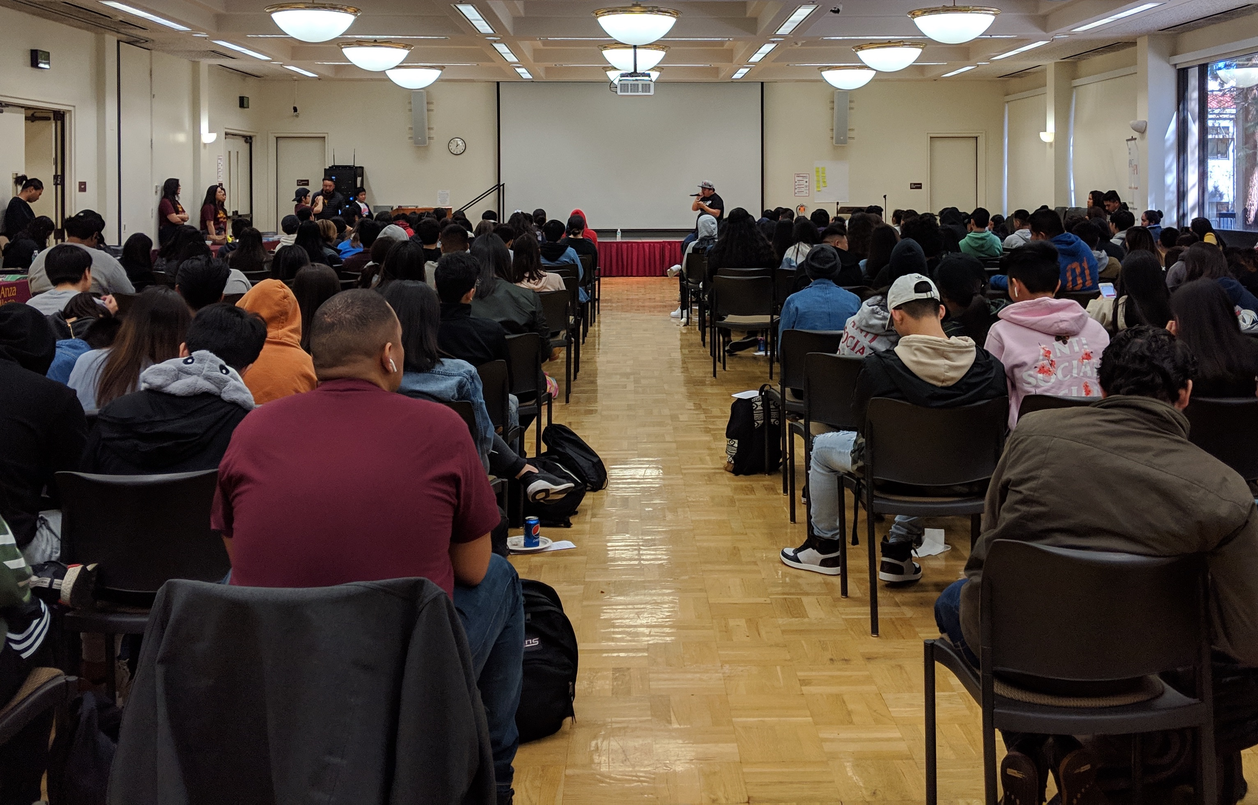
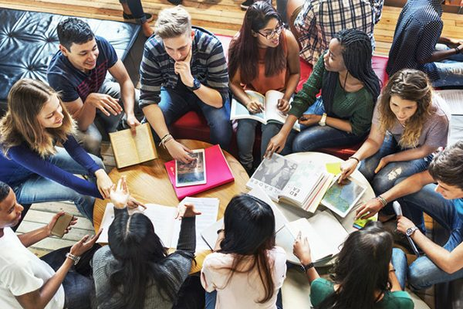
User Groups
Campus
Community
Rentals
District

Slide 3
Possible Building Elements
Conference /Meeting Spaces
Student/Education spaces
Lounges
Meetings
Flexibility
Performance Spaces/Theater
Types of Performances
Stage
Seating Style
Performance Preparation (Green Rooms, Dressing Rooms, Restrooms)
Rehearsal Spaces
Instrument Storage
Back-of-house (set/production) storage and staging
Food Serving
Kitchen
Serving Style
Dining/Eating locations
Gift Shop
Key Building Facilities
Restrooms
Elevators
Utility Rooms
Storage
Lobby

Slide 4
Existing Theater Buildings
Visual Performing Arts Center (De Anza) Flint Center (De Anza)
Overall Building Size = 26,258 square feet Overall Building Size = 84,218 square feet
Stage Size = 2,942 square feet Stage Size = 4,656 square feet
Number of Fixed Seats = 400 Number of Fixed Seats = 2,570
(Euphrat Museum = 2,000 square feet)
Smithwick Theater (Foothill)
Overall Building Size = 24,460 square feet
Stage Size = 1,635 square feet
Number of Fixed Seats = 941

Slide 5
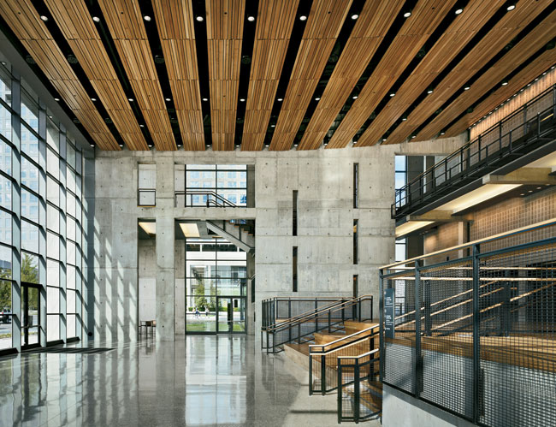
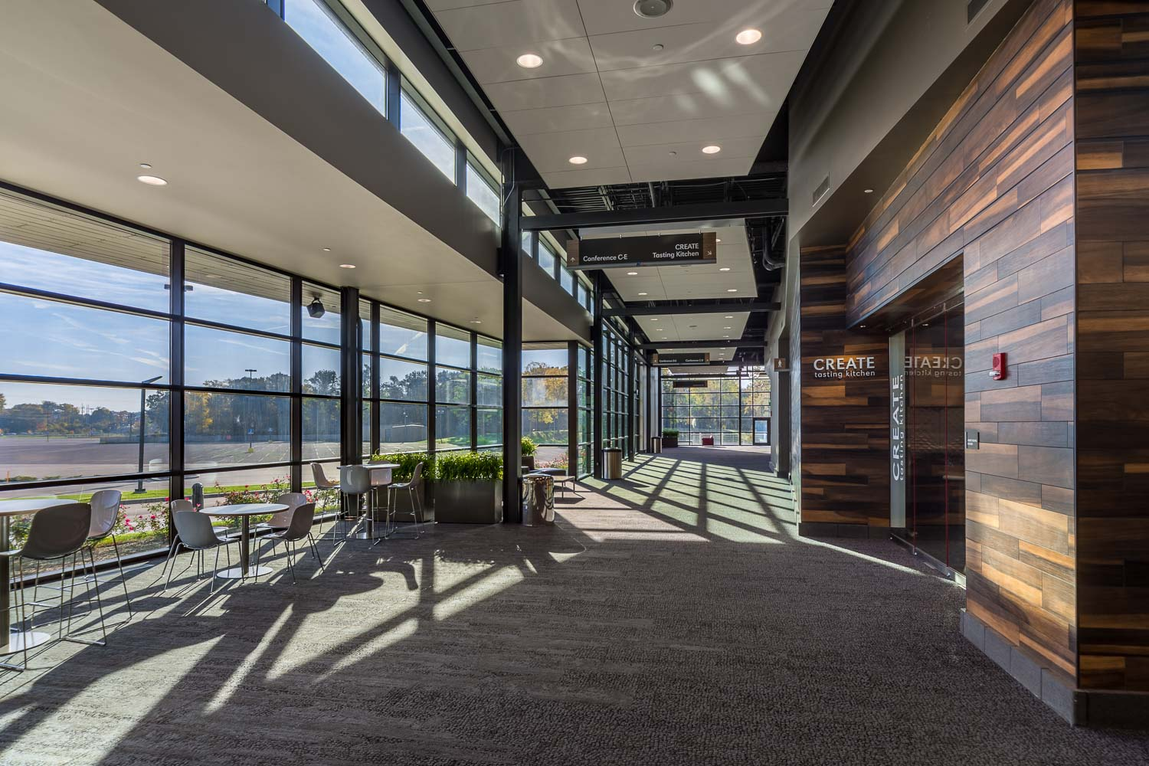
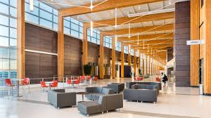
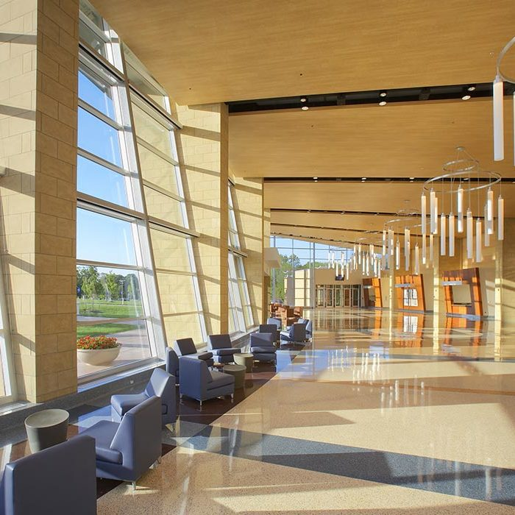
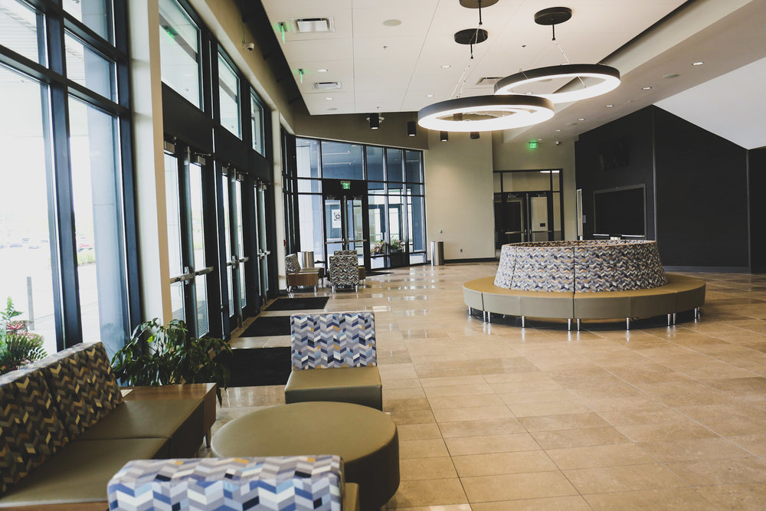
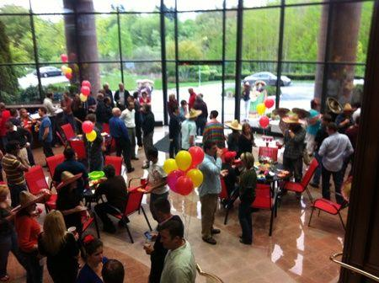
Lobby
Entrance
Gathering
Event location – concession, ticketing, check-in

Slide 6
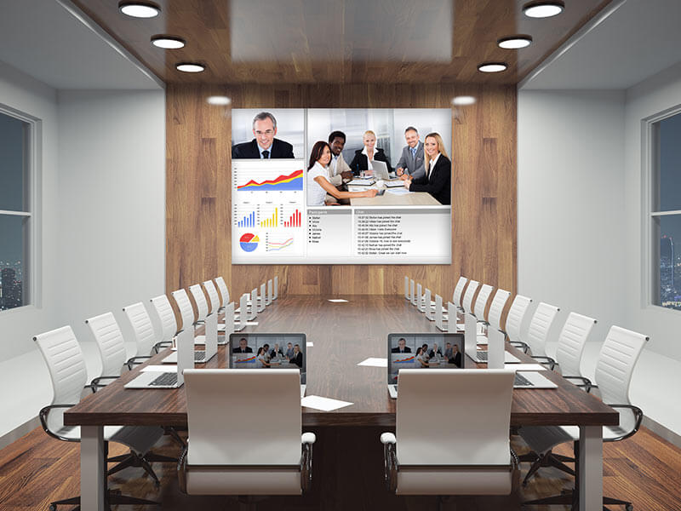
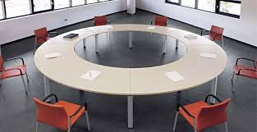
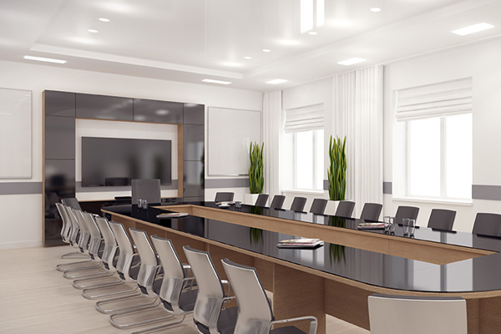
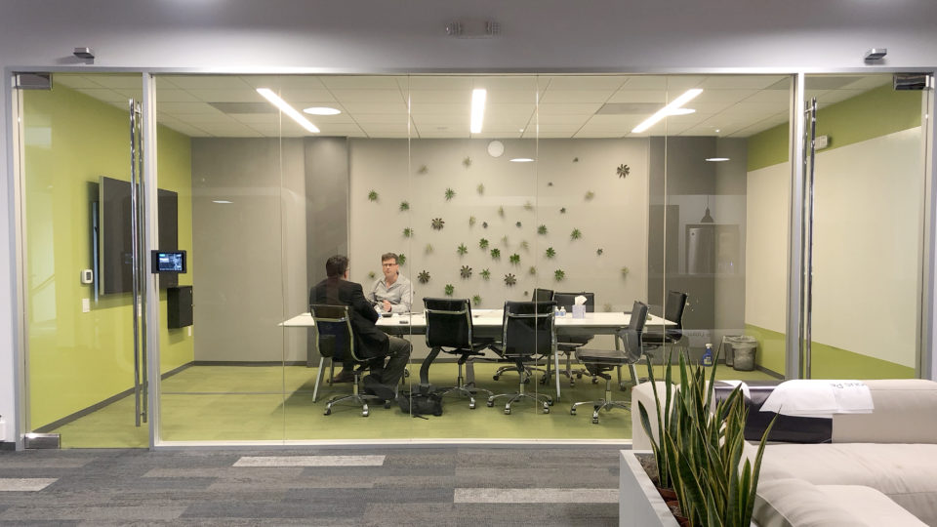
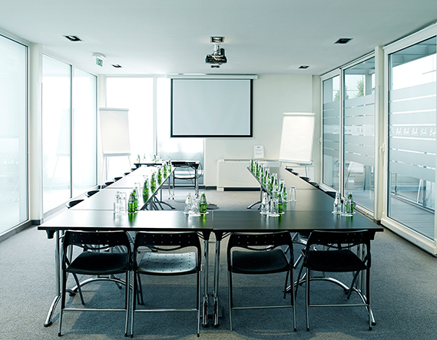
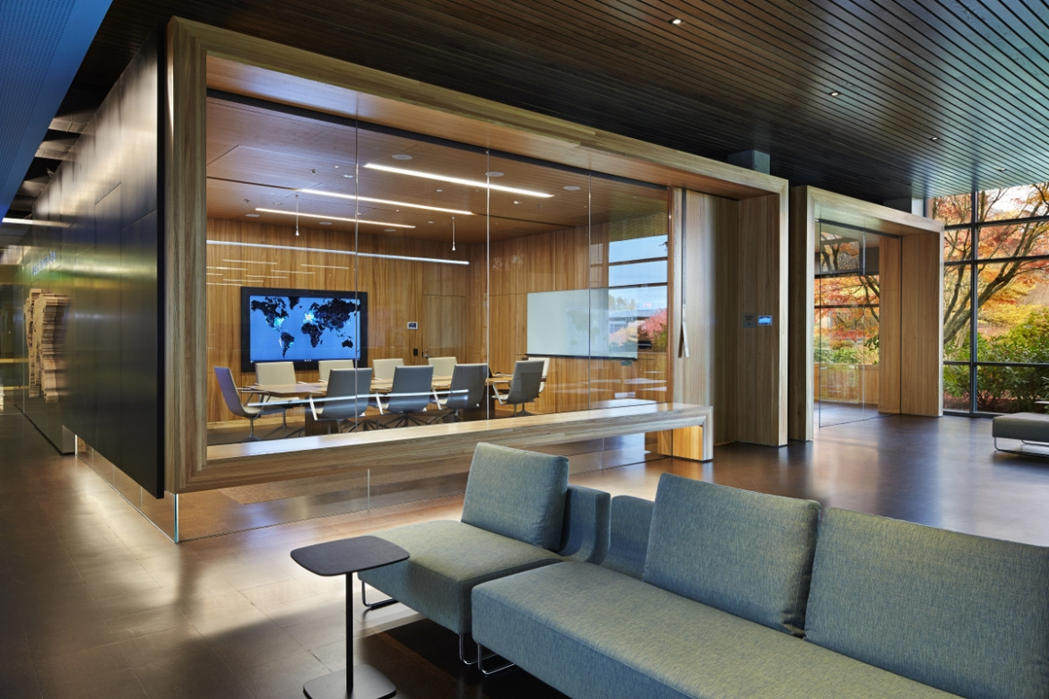
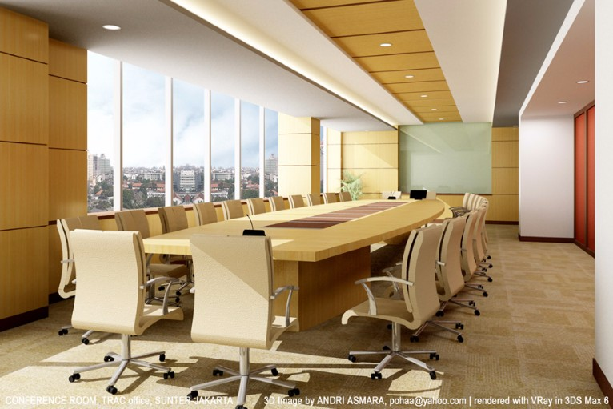
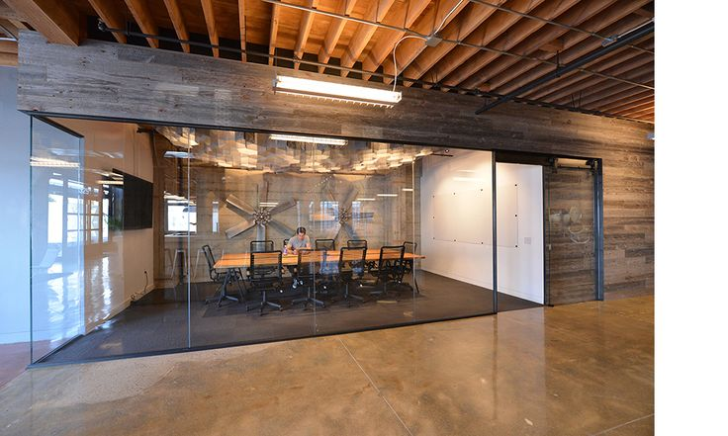
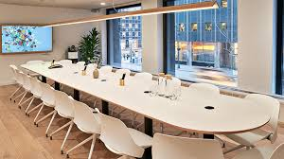
Meeting Spaces
Smaller Conference Room Functions
Flexible
Visibility/Privacy
User Groups
Campus
Students
Public

Slide 7
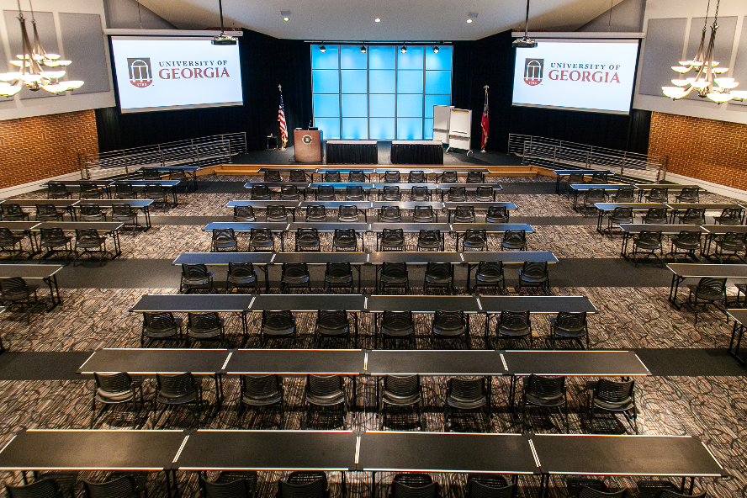
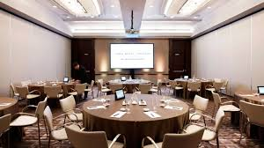
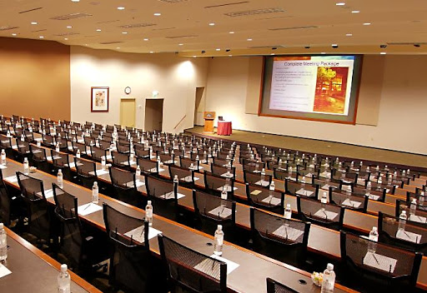
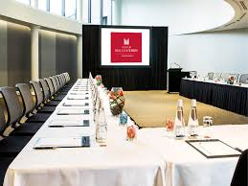
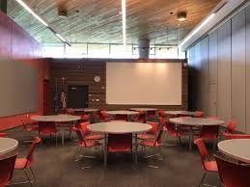
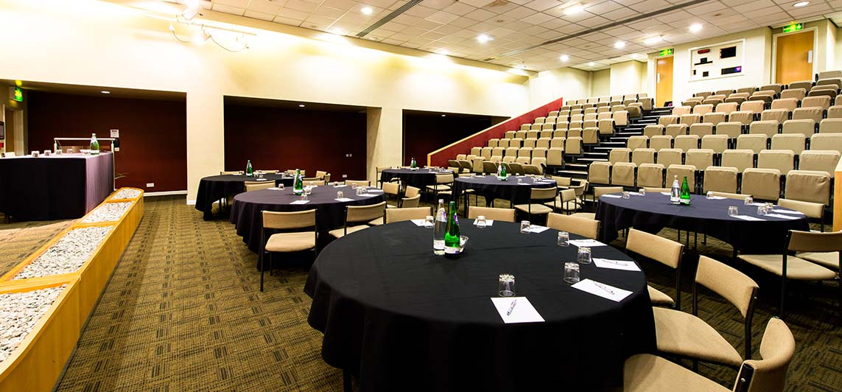
Conference Rooms
Larger scale than meeting rooms/ spaces
Flexible setups
Dining
User Groups
Campus
Students
Public

Slide 8
Existing Campus Conference Rooms
Campus Center
Conference Room A
Size of Room = 43’ x 54’ = 2322 square feet
130 Person Seating Theater style
72 Person Table Seating
Conference Room B
Size of Room = 54’ x 54’ = 2,916 square feet
200 Person Theater style seating
125 Person Table style seating
Forum 1 Classroom
Size of Room = 3,922 square feet
Number of People = 323
Conference Room Admin 109
Size of Room = 970 square feet
Number of People = 40
Conference Room Admin 106
Size of Room = 548 square feet
Number of People = 20

Slide 9
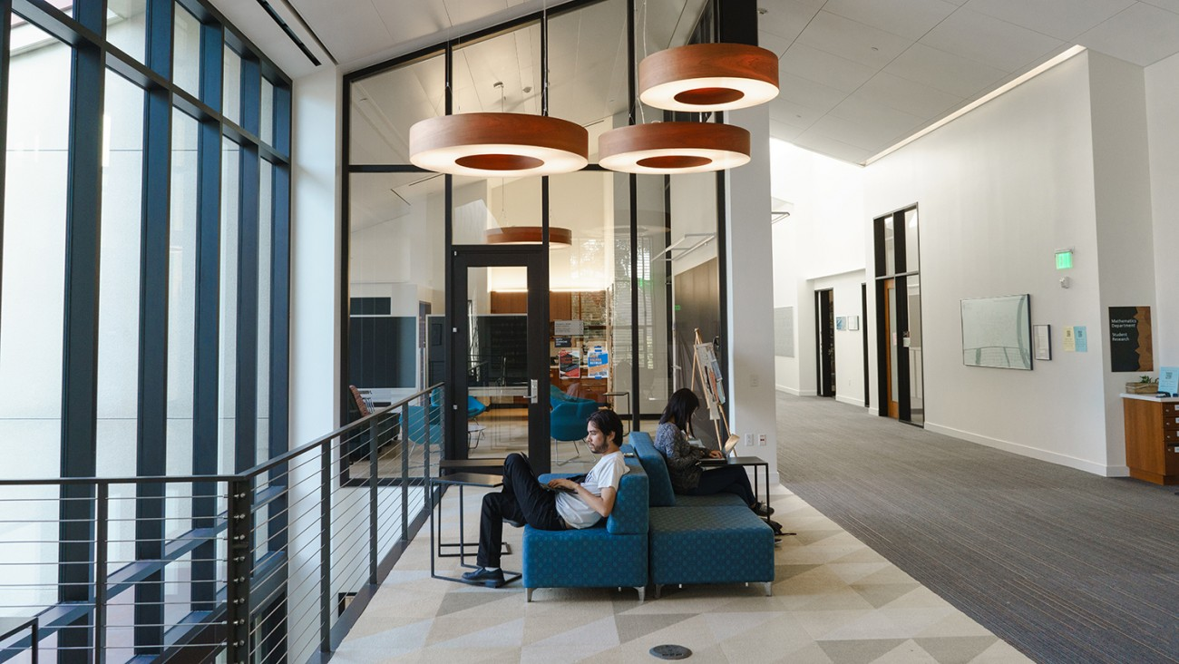
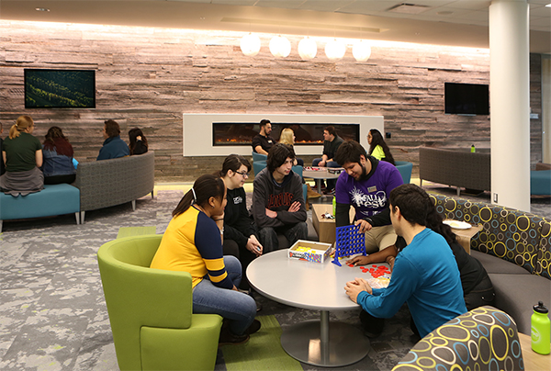
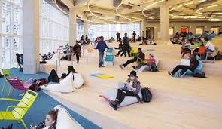
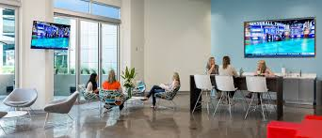
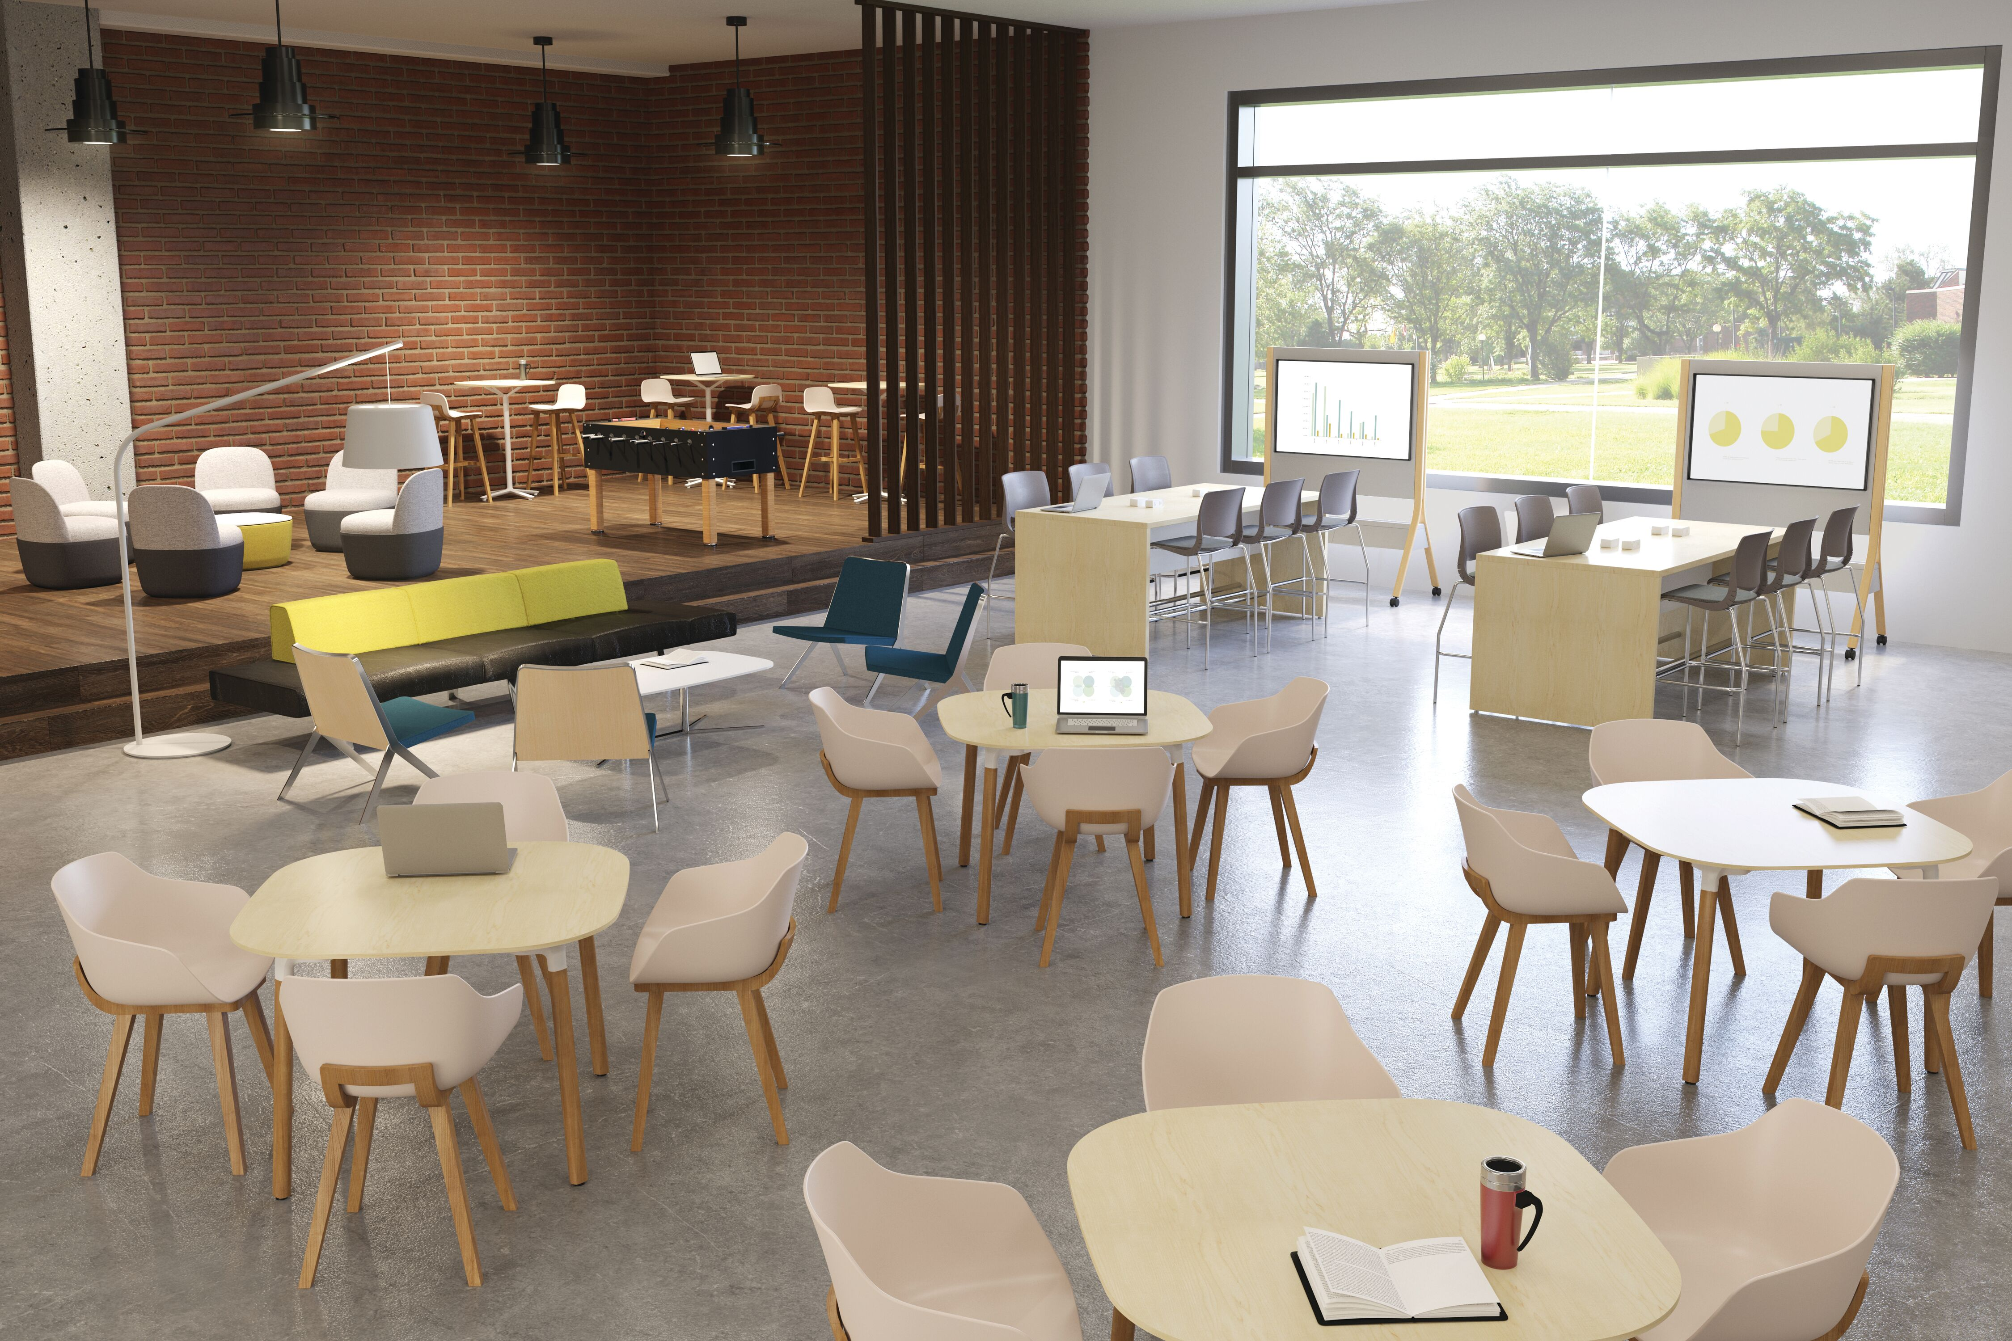
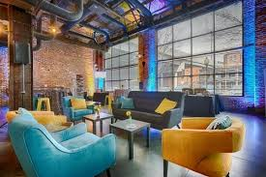
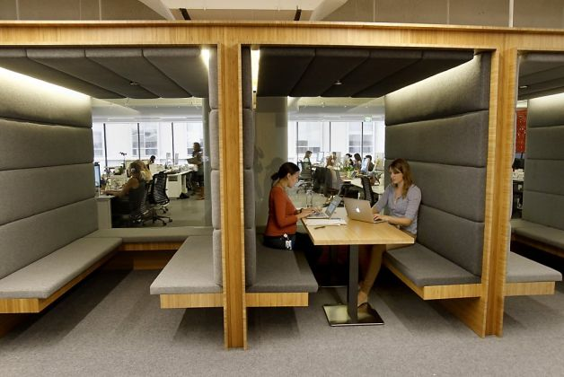
Gathering Spaces
Collaboration
Lounge
Visitor Use
Student Use
Destination/Accidental

Slide 10
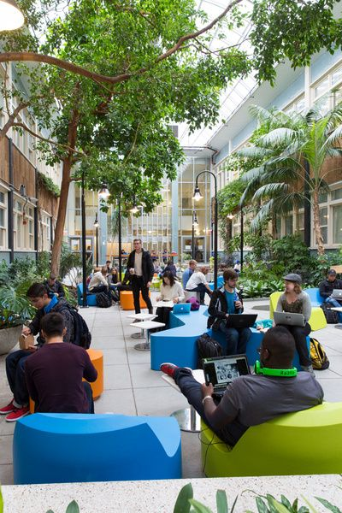
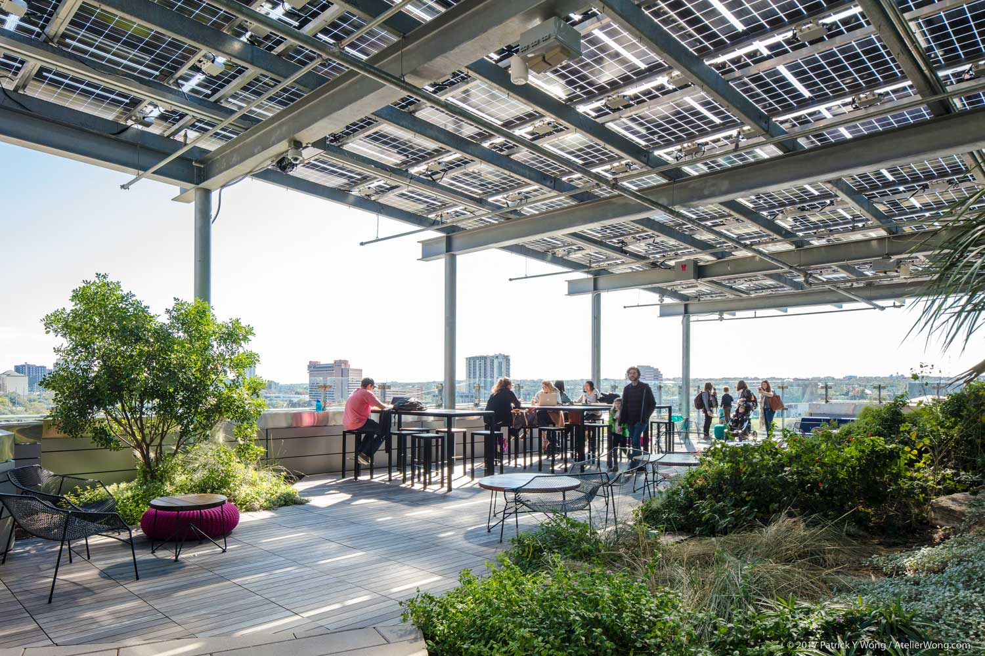
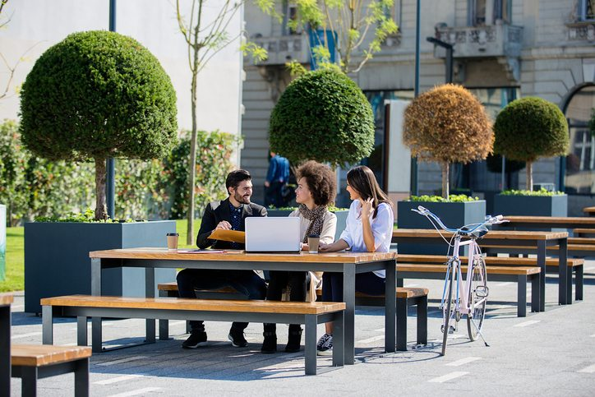
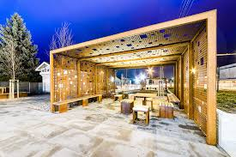
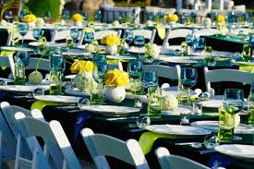
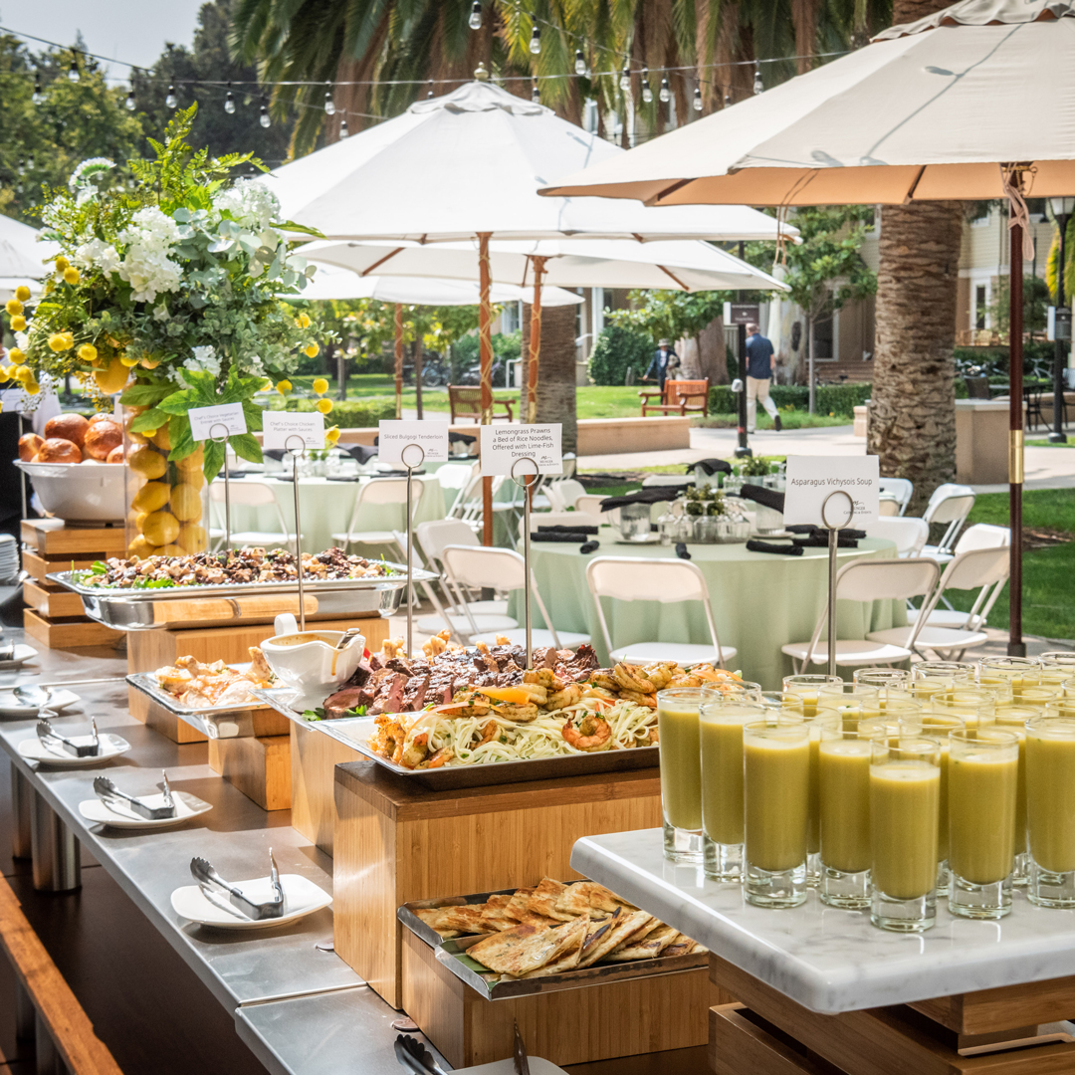
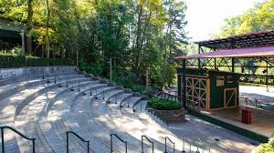
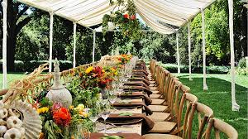
Exterior Public Spaces
Gathering
Events
Location
Rooftop
First Floor
Security
User Groups
Campus
Students
Public

Slide 11
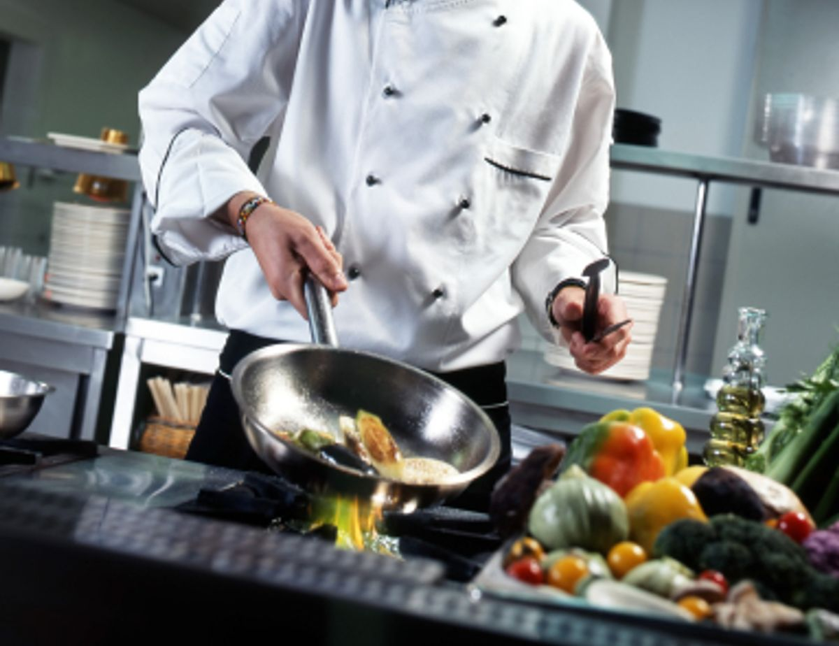
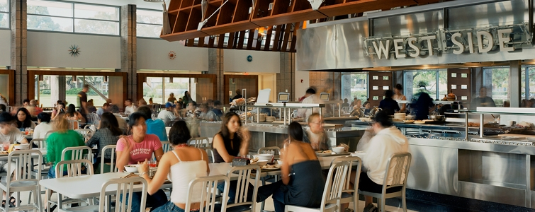
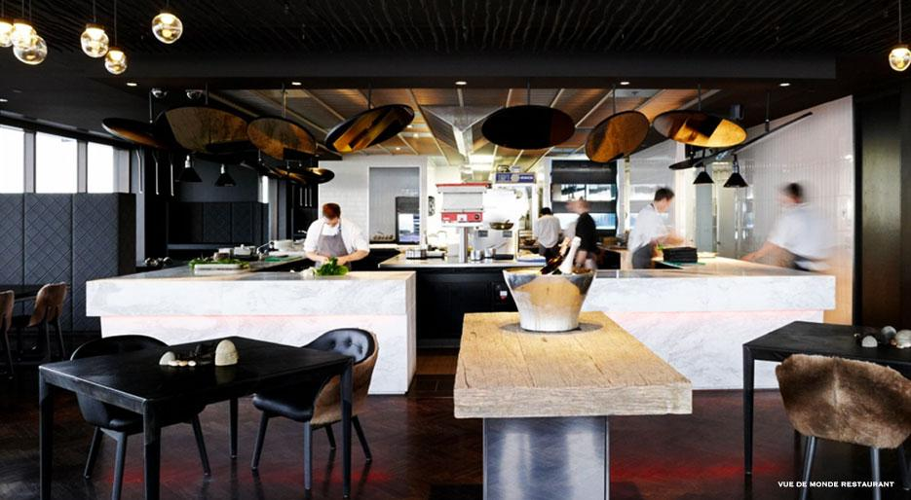
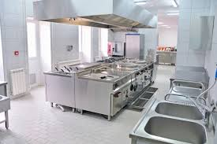
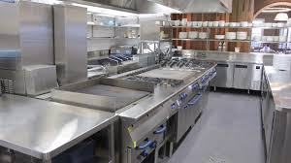
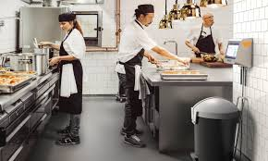
Kitchen
Food Preparation
Food/Beverage Services
Planned
On Demand (Open Kitchen)
User Groups

Slide 12
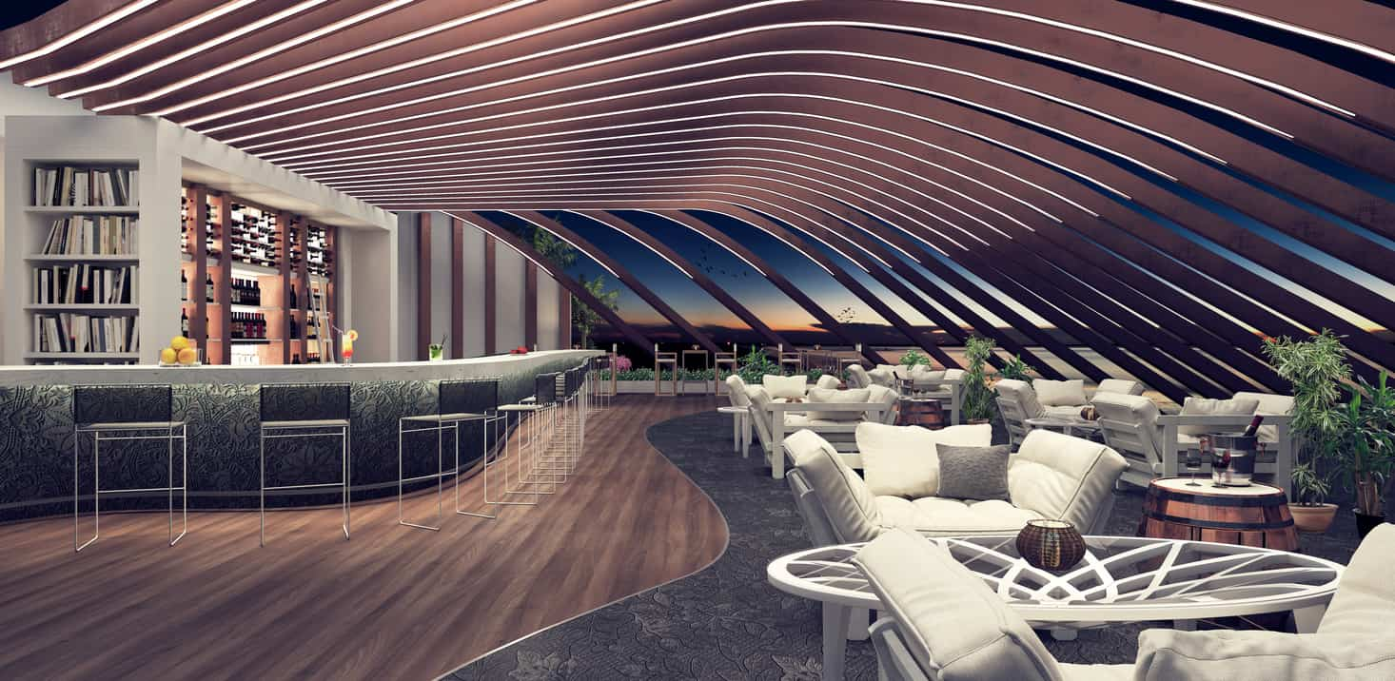
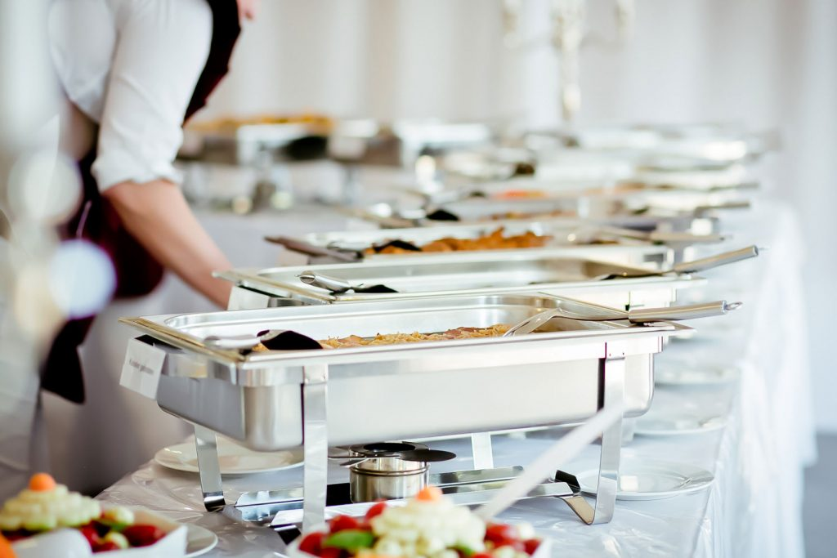
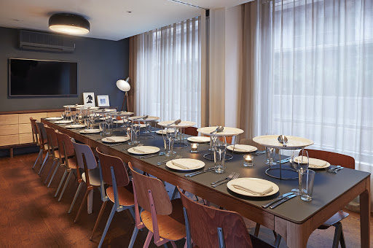
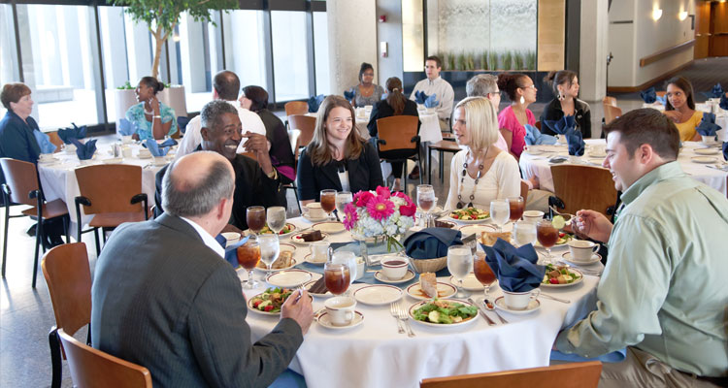
Dining
Types of Services
Seated Served
Buffet
Group Sizes
On Demand (open kitchen)
User Groups

Slide 13
Performance Spaces
Theater Productions
Music Venue
Dancing Venue
Speaking Functions
Seating Style/Layout
Stage Size/Function

Slide 14
Performance Spaces cont.

Slide 15
Performance Spaces - Additional
Practice Areas
Storage
Preparation
User Groups

Slide 16
Exterior
Main Entrance
Campus Gateway
Statement

