Slide 1
Extending Canvas with Insights
Mary Pape

Slide 2
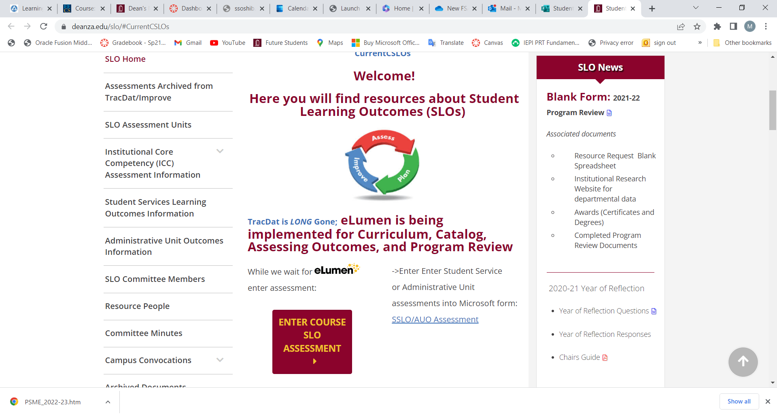
Document the Assessment

Slide 3
Documenting Your Assessment
Select your Division *
Enter the name of your department *
Enter the name of the course with section. For example, MATH 22-50Z *
Enter CRN# for course *
Enter SLO Statement(s) As it (they) appear on the Course Outline of Record. You may assess one or more at a time. *
Academic Year *
Quarter of Assessment *
Modality of class *
Method of Assessment *
Elaborate on Assessment Method *

Slide 4
Documenting Your Assessment
11. Number of students exceeding expectations
12. Number of students meeting expectations
13. Number of students approaching expectations
14. Number of students who do not meet this/these outcome(s)
15. N/A Not Applicable (withdrew, absent, ...)
16. Reflection *
17. Enhancement/Action *
Or let Canvas do it for you: Canvas & Outcomes Assessments

Slide 5

Overview of Insights for Canvas Outcomes
Insights for Canvas Outcomes expands the functionality of Canvas Outcomes.
Insights for Canvas Outcome Video
Goals
Map course level student learning outcomes to program level outcomes thereby indirectly assessing programs.
Map course level student learning outcomes to institutional level outcomes thereby indirectly assessing ILOs.
Combine CSLO assessment outcomes with demographic data for Equity reporting.

Slide 6
Overview of Insights for Canvas Outcomes
Insights for Canvas Outcomes expands the functionality of Canvas Outcomes.
Insights for Canvas Outcome Video
What Insights does to accomplish this.
Provides a means to map CSLOs to Program Level outcomes.
Provides a means to map CSLOs to Institutional Level outcomes.
Provides the means to associate each outcome to a course so that is the outcome the faculty member finds.
Provides the means to push out a rubric to each department/area.
Preserves a place to collect reflections and enhancements.

Slide 7
The Groundwork
Outcomes - must be associated to the course. CSLOs will be uploaded from eLumen export. Mapping will need to happen within Insights for each course by each department.
Rubrics - must be associated to the course. Same scale as used for Microsoft Form will be adopted.
Assignments - must be graded using SpeedGrader.
Grades - course-level outcome results can be viewed in the Learning Mastery Gradebook. Instructor in Canvas navigates to Setting -> Feature Options and is able to toggle on and off whether students see Mastery grades.

Slide 8
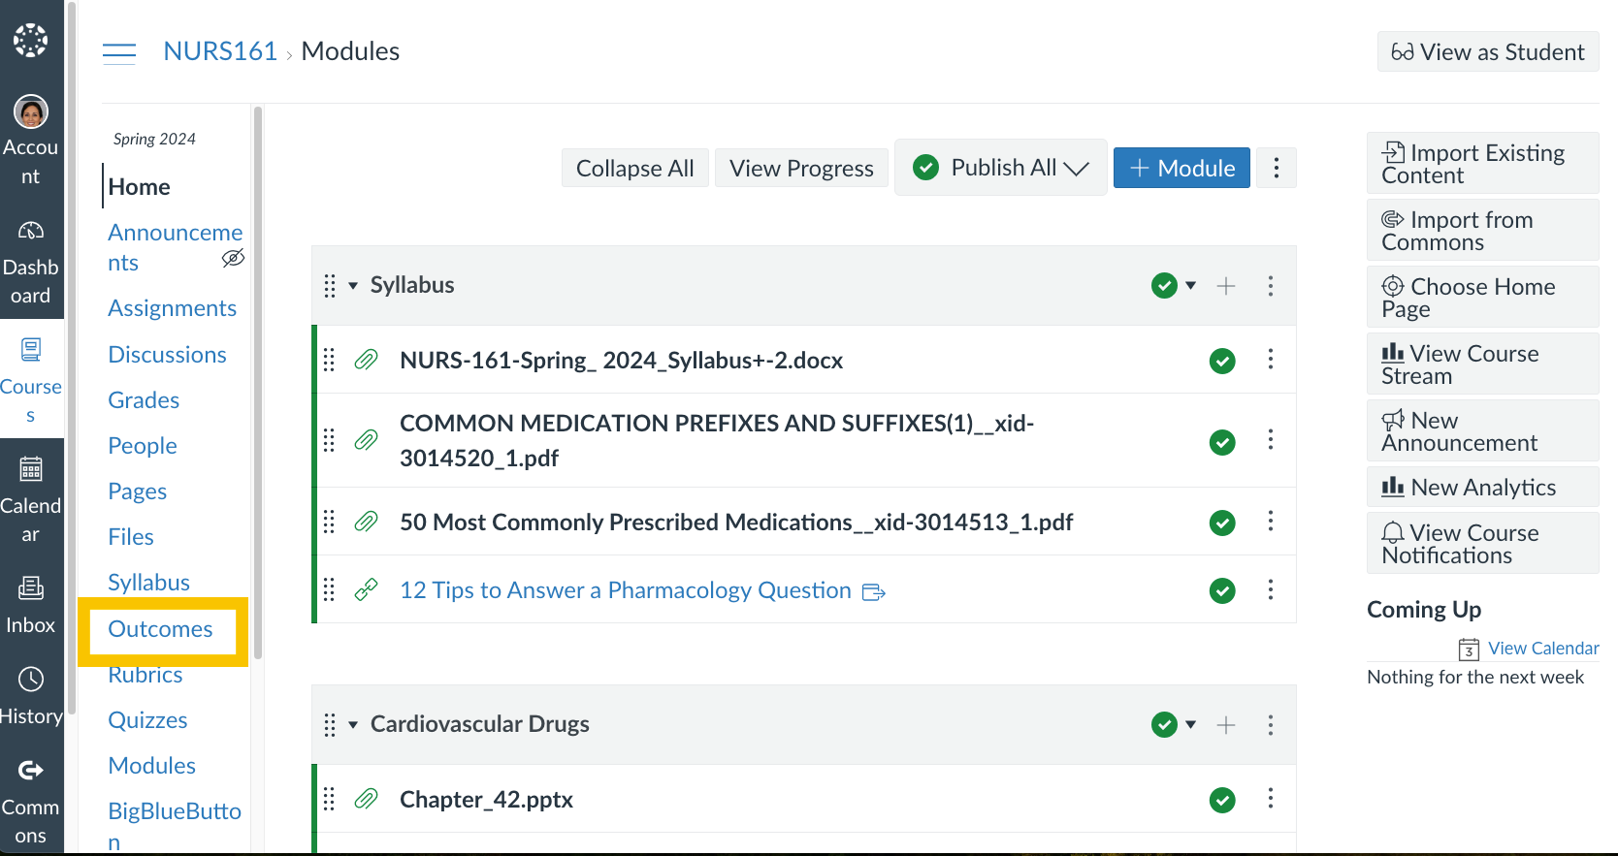
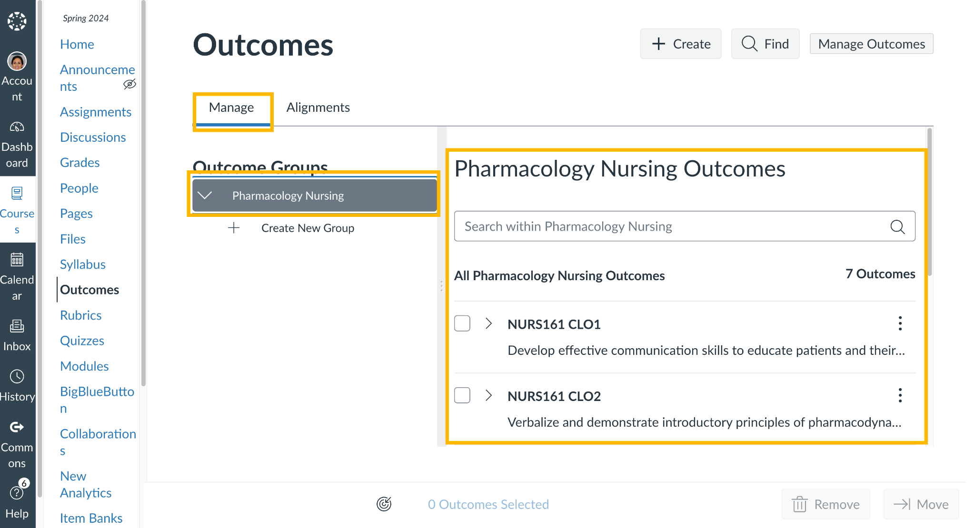
Step 1: Outcomes: Review the outcomes associated with your course.
Let’s review the outcomes in your course.
Once in your course in Canvas, click on Outcomes in the left hand navigation toolbar of your course.
To view the approved learning outcomes associated with your course, select Manage sub-tab under Outcomes; then below Outcome Groups, select the course name and associated outcomes are displayed in the right hand panel.

Slide 9
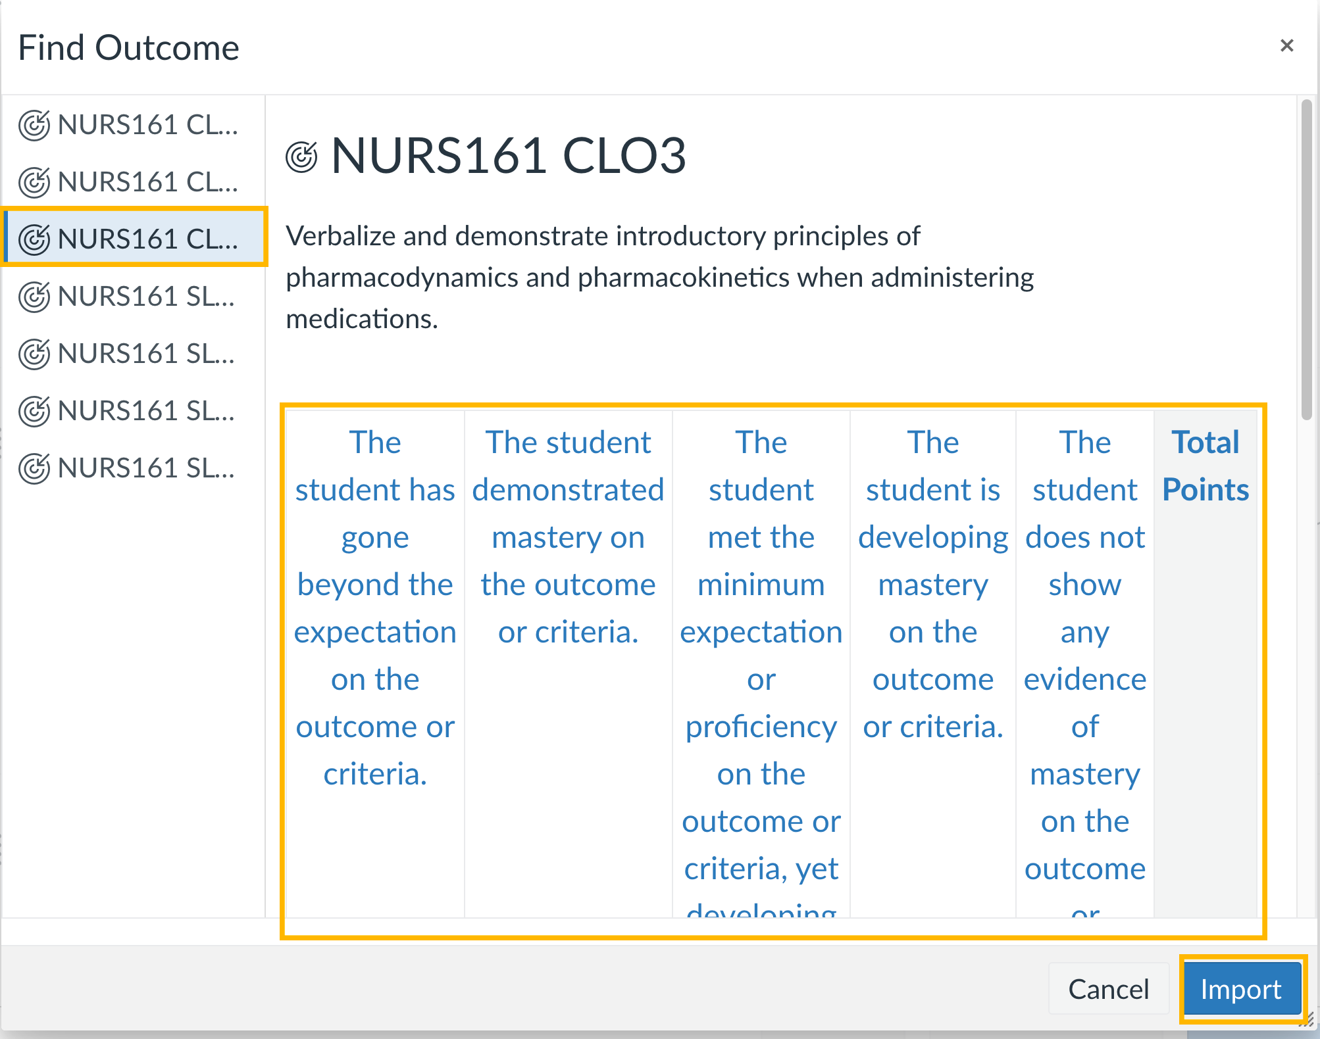
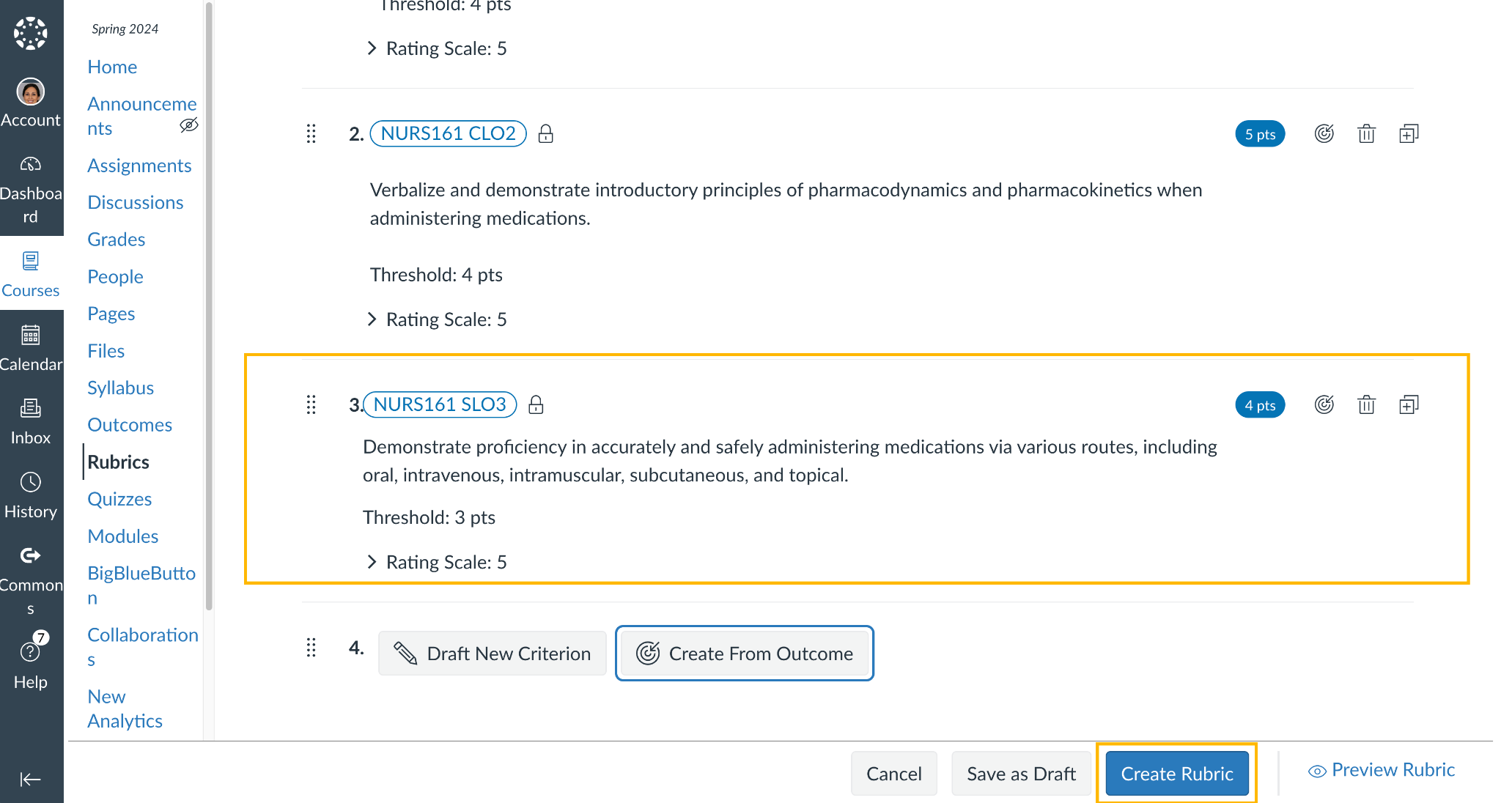
Step 2: Rubrics: Modify an existing rubric to add an outcome
As with creating a rubric, select the outcome you would like to use in the rubric from the modal window Find Outcome.
Once Selected, confirm that the mastery levels are mapped correctly for the outcome and click Import.
Once the Outcome is added added to your Criteria you will see it on your list.
Continue adding outcomes as needed.
When finished click Create Rubric and the rubric will be added to the bottom of your list of rubrics for the course.

Slide 10
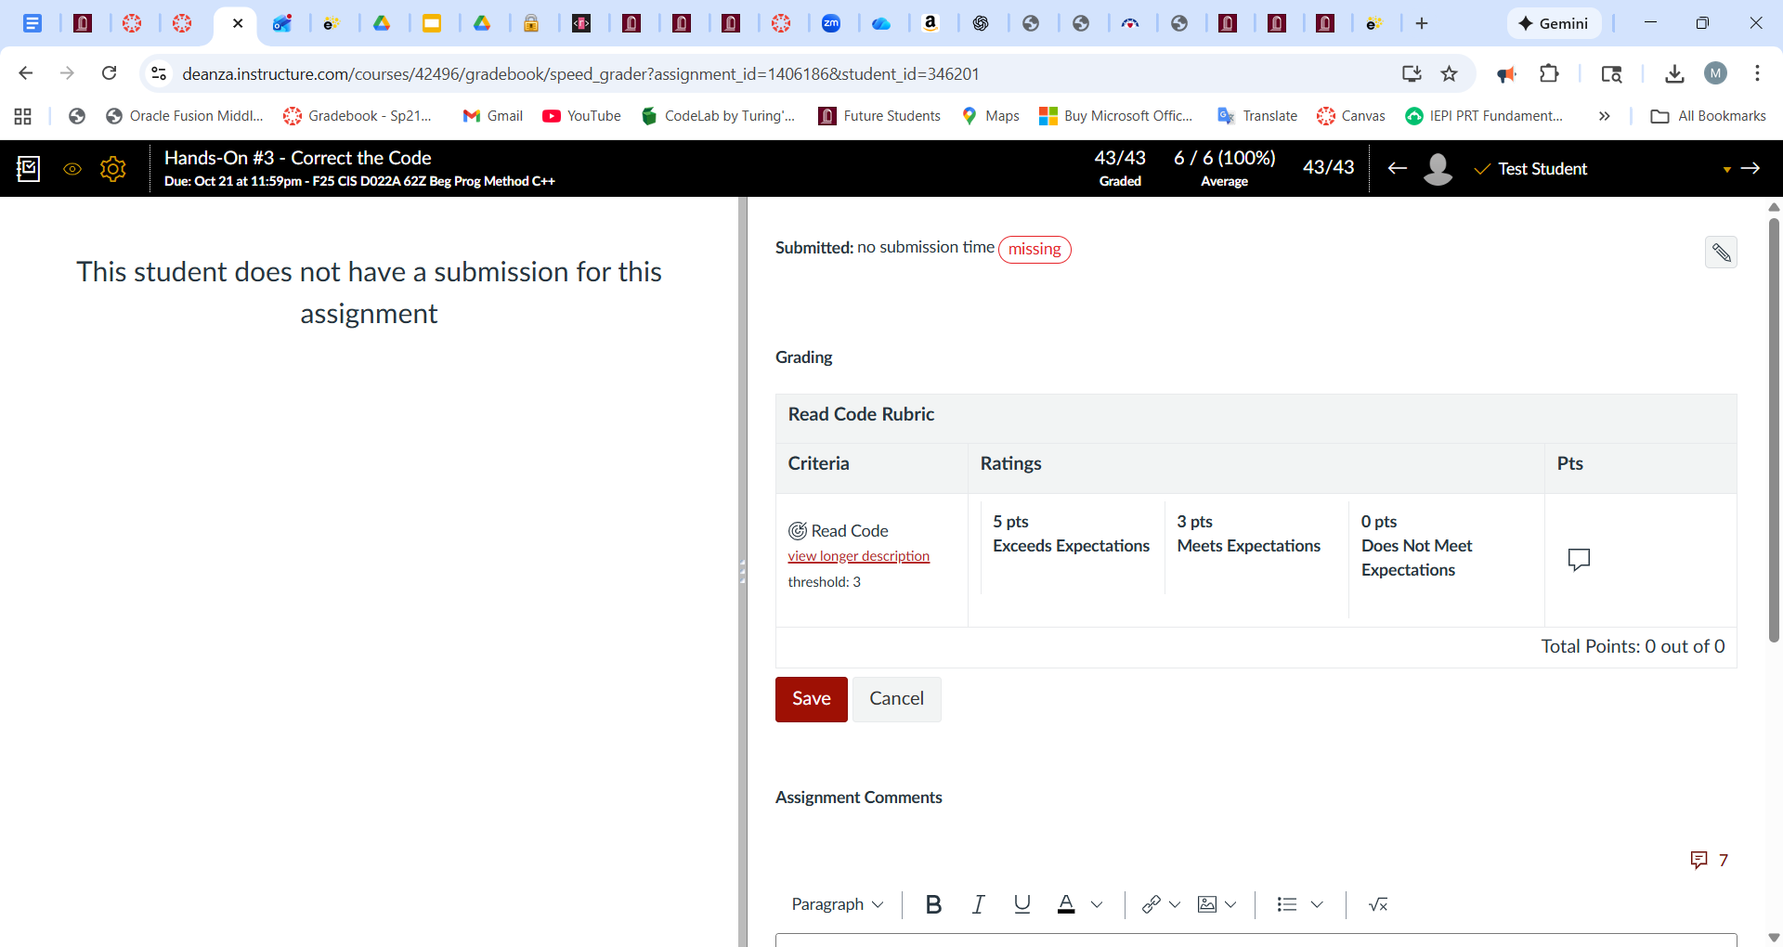
Step 3: Grade assignment on SpeedGrader

Slide 11
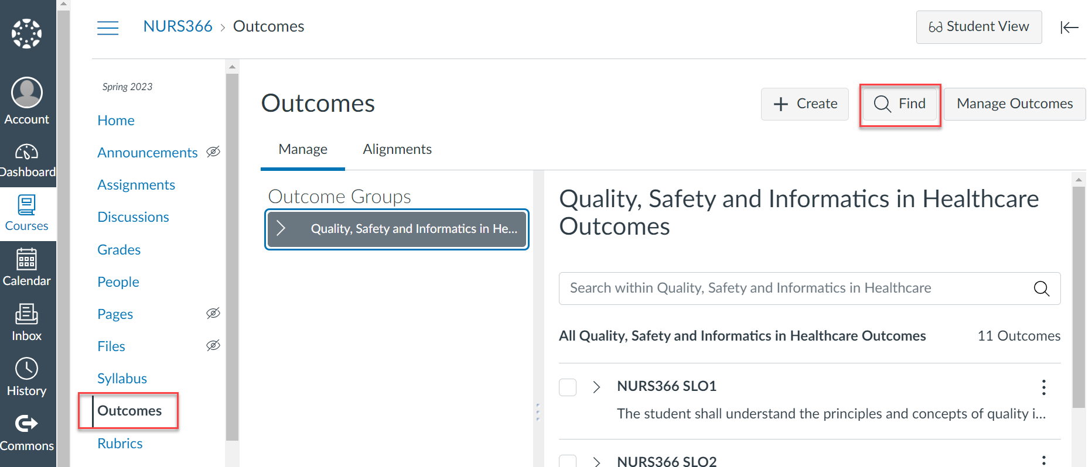
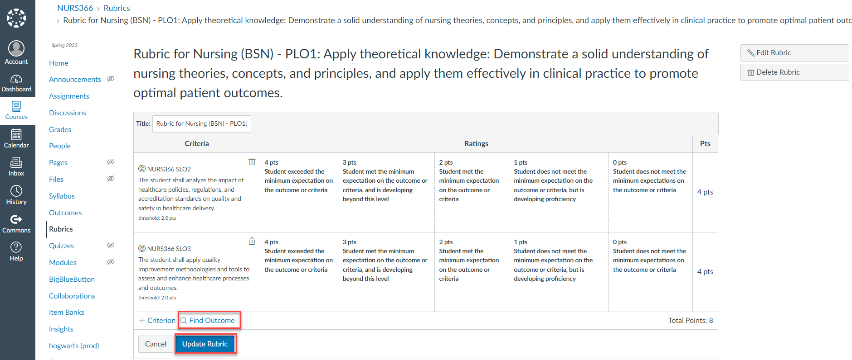
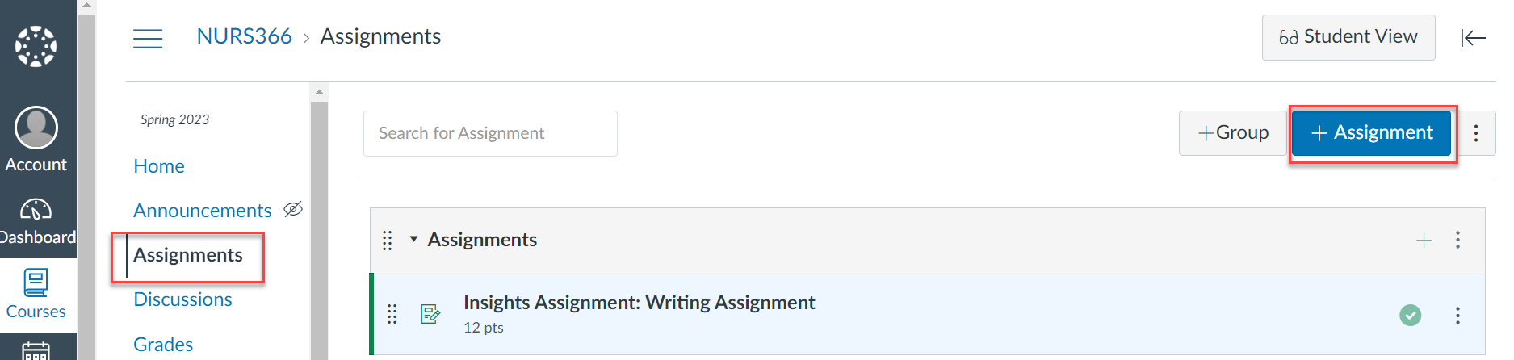
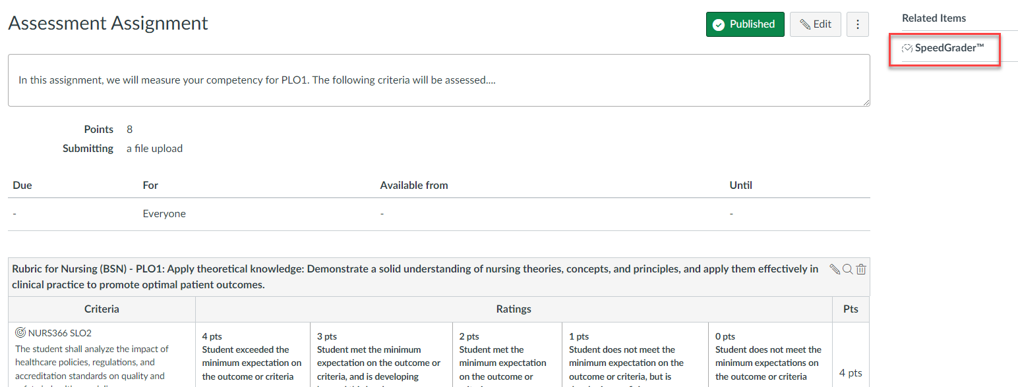
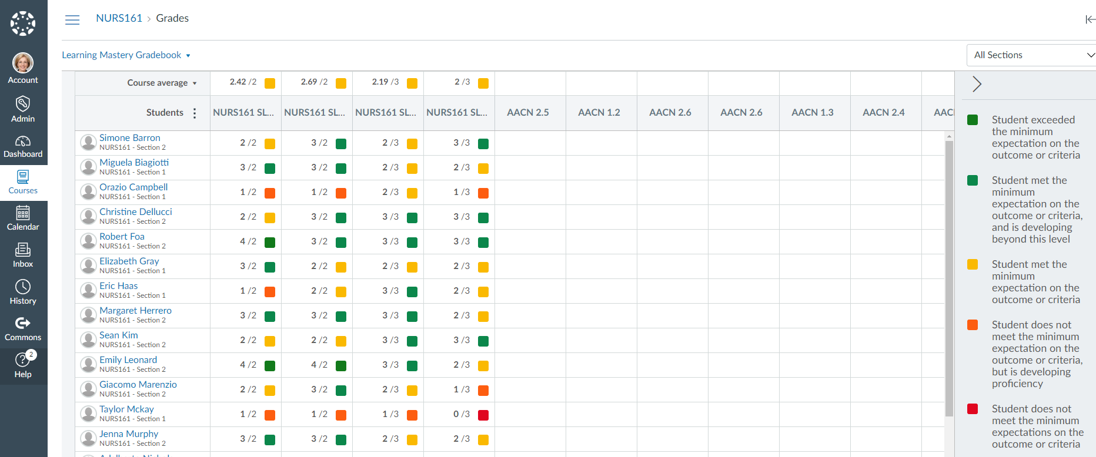
Canvas Workflow
1. Outcomes - must be associated to the course.
2. Rubrics - must be associated to the course.
3. Assignments - must be graded using SpeedGrader.
4. Grades - CSLO results can be viewed in Canvas.
Insights Knowledge Base Article - Canvas Workflow
Notes:
So as a recap of this faculty process in Canvas, outcomes must be associated to the course, rubrics must be associated to the course, assignments are then created and published, and must be graded using SpeedGrader, and then you can view those CLO results in the Learning Mastery Gradebook.
Next session we will connect this process to the Insights workflow and outcome management in Insights.

Slide 12
Learning Mastery Gradebook
Assessment results are visible in the Learning Mastery Gradebook. Results can be downloaded via CSV (Excel) file and manually calculated (without Insights).

Slide 13
Grading in Canvas: SpeedGrader
Assess with SpeedGrader.
Once all student submissions have been collected for the assignment, faculty can assess. In the assignment, click on SpeedGrader and complete assessing your students.
Assessment results are visible in the Learning Mastery Gradebook. Results can be downloaded via CSV (Excel) file and manually calculated (without Insights).

Slide 14
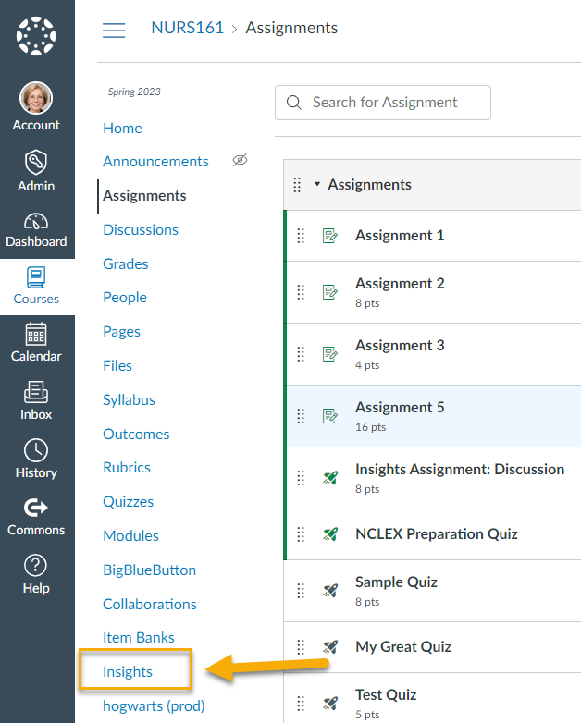
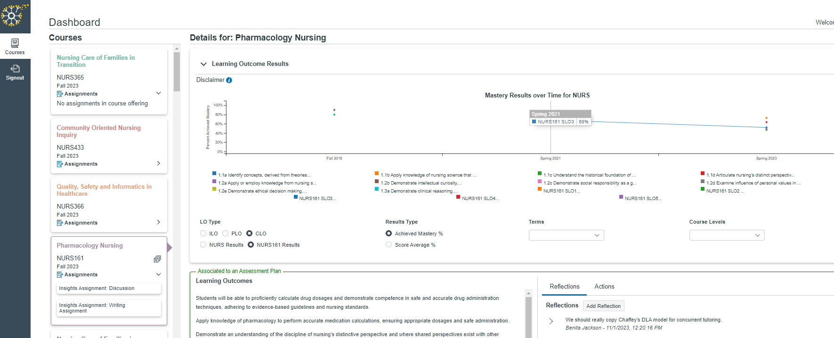
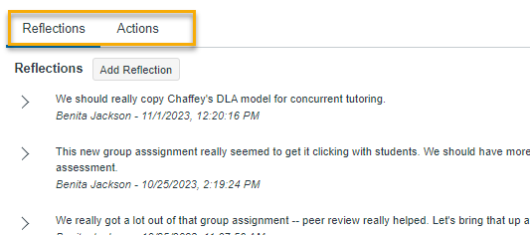
Insights Workflow
2. Dashboard- view course/assignment data.
1. Insights- access Insights from course navigation.
3. Narrative- Add reflections and improvement actions.
Insights Knowledge Base Article - Insights Workflow

Slide 15
As a Faculty Member: What will I be able to see and do in Insights once scoring is complete?

Slide 16
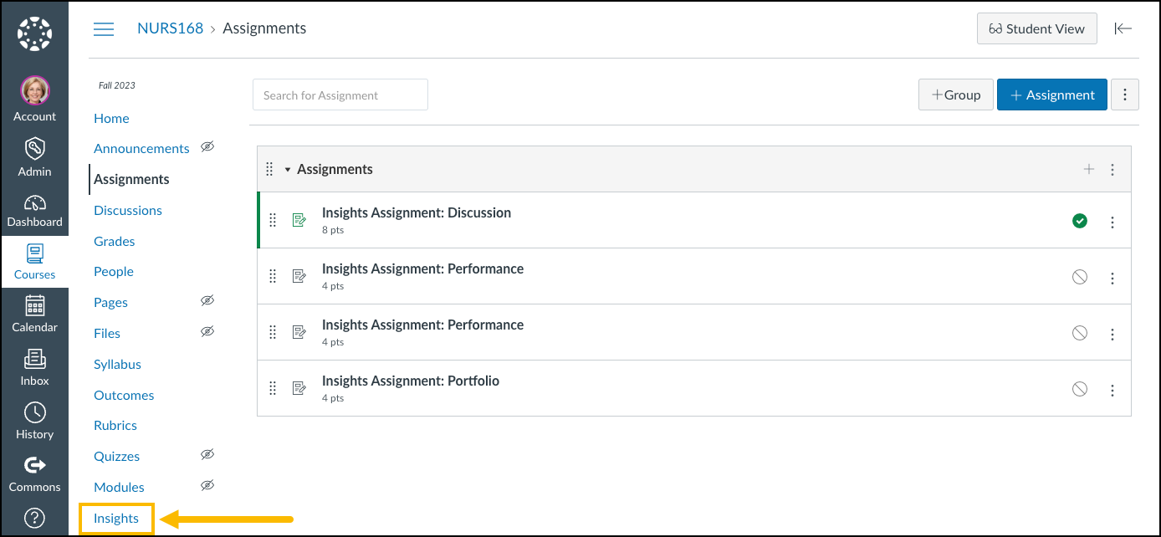
Accessing Insights from Canvas
Once Scoring has been completed in Canvas SpeedGrader, you can access Insights by selecting the Insights option from the Canvas course navigation.
Insights will open in a new tab.
They will then be able to:
View performance metrics and outcome data.
Enter course reflections.
Enter course actions.

Slide 17
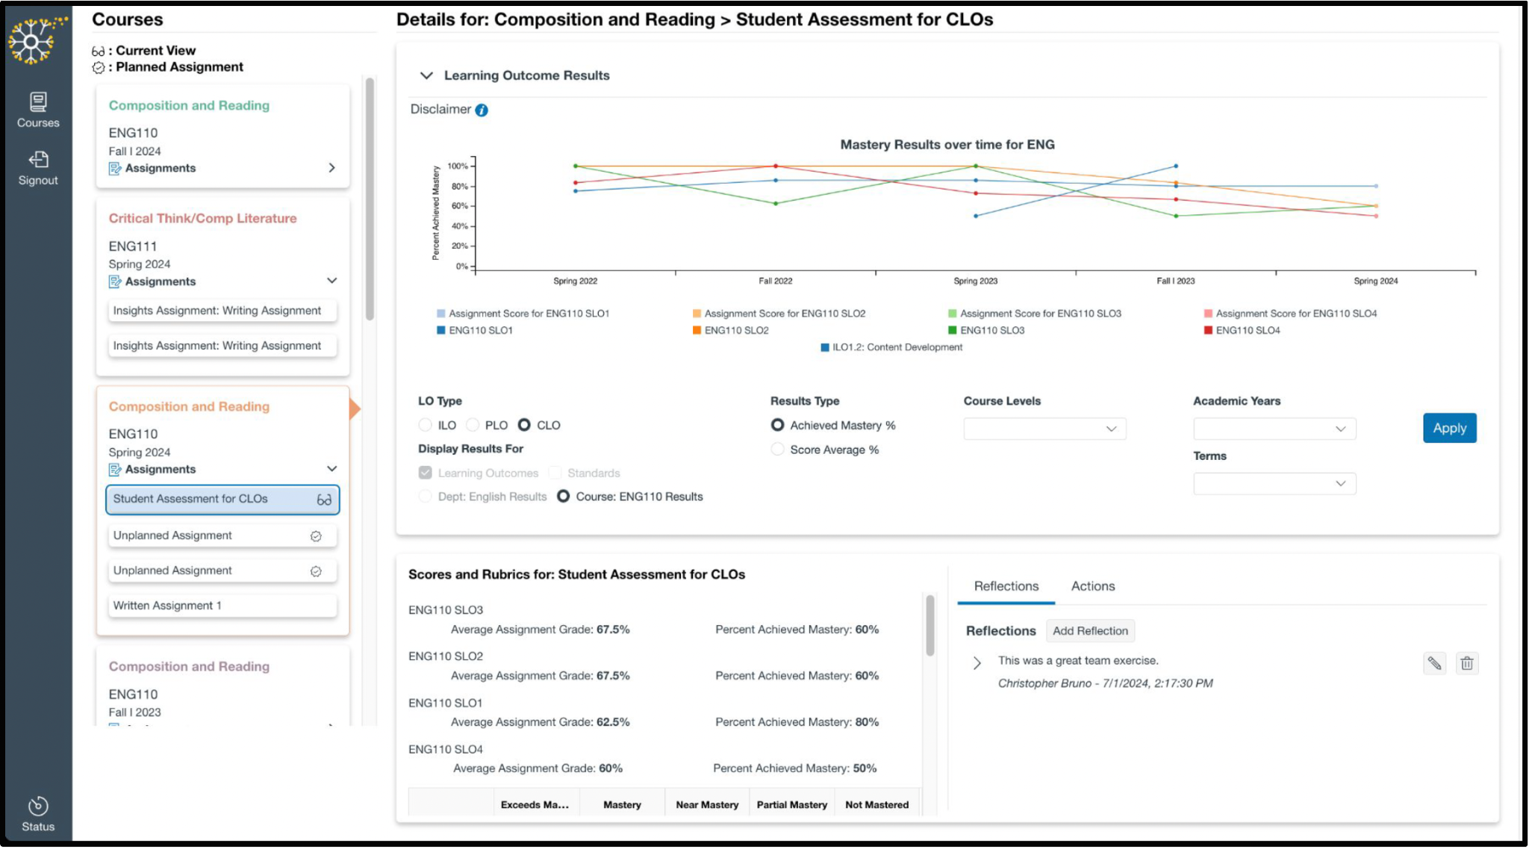
1: View performance metrics and outcome data.
By default you will land on Courses Dashboard of Insights.

Slide 18
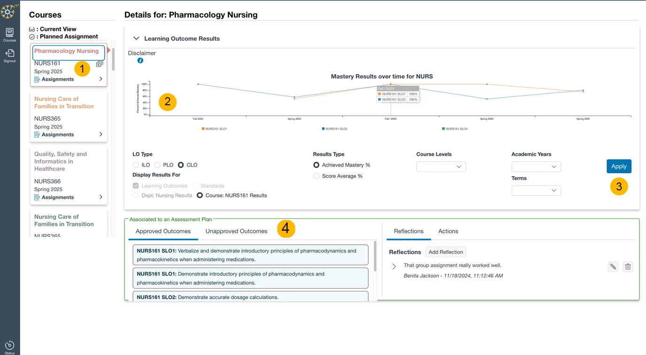
1: View performance metrics and outcome data.
Courses:
Only courses taught by the user logged in will be displayed.
Click the course name from the displayed courses and the Learning Outcome Results (to the right) will update accordingly.
In a course tile, click the right chevron icon (>) to expand and display the list of Assignments in the course.
Hover over segments of the Learning Outcomes Results graph to see the details that make up that measurement.
Customize the graph results by choosing specific options in any of the filters (LO Type/Results Type/Academic Years/Terms/Course Levels).
Learning outcomes are displayed for the course selected on the left. If a specific assignment within the course is selected, then scores and rubrics will display here. Unapproved outcomes for a course can be seen by selecting the Unapproved Outcomes option.

Slide 19
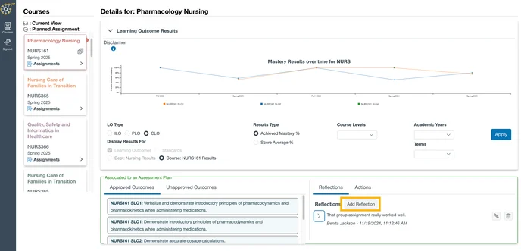
2: Enter course reflections.
Faculty can enter reflections to foster continuous improvement, enhance the learning experience for their students, and contribute to the broader goals of their institution.
To enter a narrative, click the course name from the left; then, in the lower right corner, click Reflections and Add Reflection.
NOTE: Reflections entered pertain to the selected course offering. The course title is noted in the "Add Reflection" window.

Slide 20
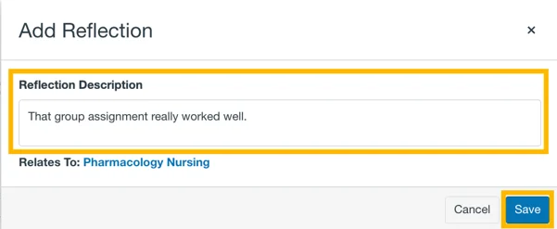
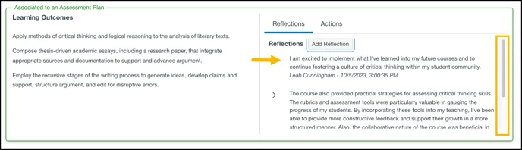
2: Enter course reflections.
In the Add Reflection modal that displays, enter in your observations and considerations into the Reflection Description field; then click Save.
The latest entry will be displayed at the top of the Reflections section. Scroll down for previous entries.

Slide 21
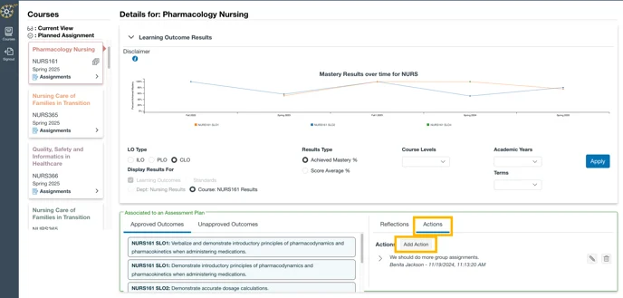
3 Option 1: Enter course actions through the Actions Menu.
Faculty can use Actions to enter the needed course modifications and revisions in response to the captured reflections.
To document a course action, click the course name from the left; then, in the lower right corner, click Actions, and then click Add Action.
In the Add Action modal that displays (See next Slide), complete the fields as outlined on the next slide and then Save.

Slide 22
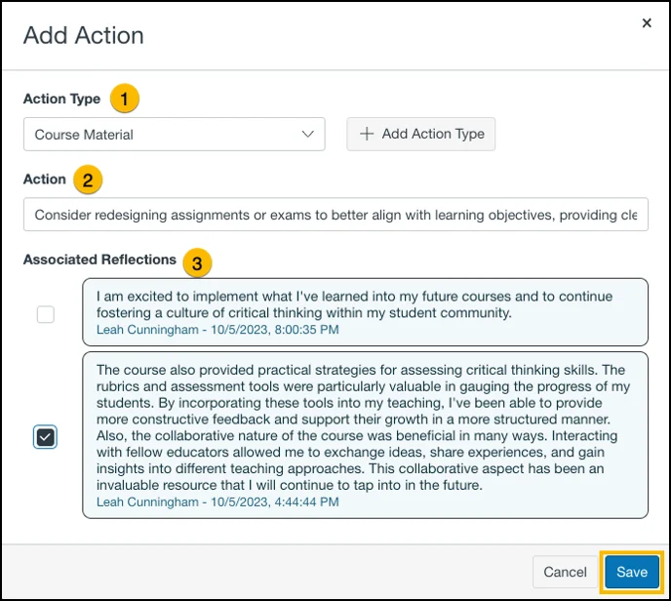
3 Option 1: Enter course actions through the Actions Menu.
Action Type: click the drop down to select the type of action for this item; and, if you do not see the desired action item listed, you may click the button + Add Action Type to create a new item.
Action: enter the specific step(s) to be taken for course improvement.
Associated Reflections: this is not required, but there is the option to check the box of recorded reflections that support this action item. When done, choose Save.

